Slide 1
County Durham and Darlington Needs Led Neurodevelopmental Pathway
Rachael Allen, Team Manager Tees, Esk & Wear Valleys NHS FT
Paula Gardner, Clinical Nurse Specialist, Tees, Esk & Wear Valleys NHS FT

Slide 2
What do we mean by “Neurodevelopmental”?
Lifelong
Difficulties including: Cognition, language, motor development, attention and concentration, emotional regulation, social communication and social interaction
Evidence that neurodevelopmental conditions co-occur
Two of the most common Neurodevelopmental conditions are ADHD and Autism

Slide 3
Why “Needs Led”?
Parents highlighted the importance of needs being met, regardless of diagnosis
Confusion over what services were available without diagnosis
Importance of a culture change across the system away from diagnosis

Slide 4
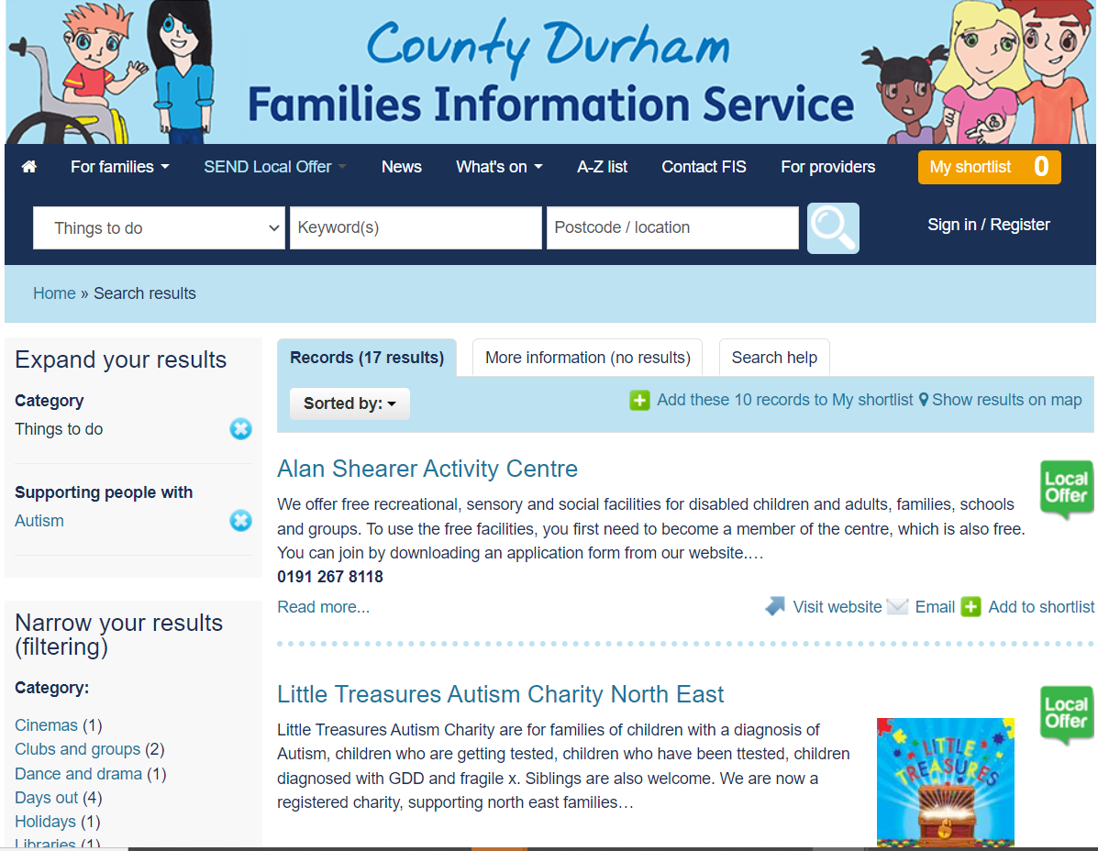
Needs Led ‘Offer’
Information brought together for the local area
Some additional funding available to minimise ‘gaps’ identified
Emphasis on support and advice being available regardless of diagnosis
County Durham's Families Information Service | Search results (countydurhamfamilies.info)

Slide 5
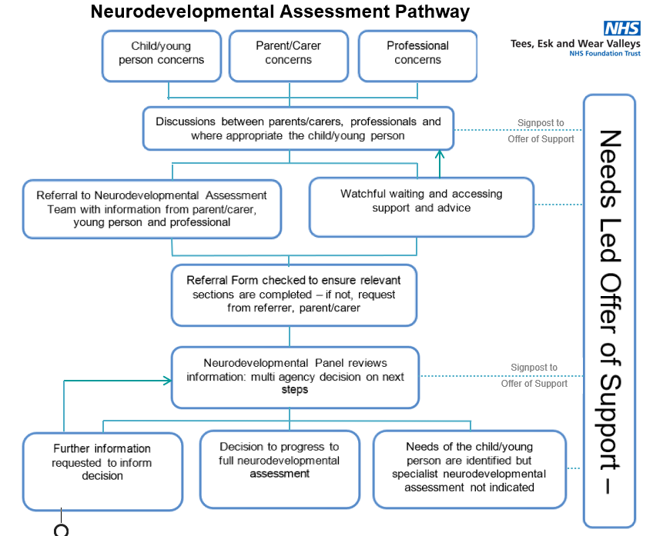
County Durham Needs Led Pathway

Slide 6
Neurodevelopmental Assessment Team
TEWV service
Brings together previous Autism and ADHD assessment pathways
CCG investment to increase capacity to meet increased demand/reduce waiting lists

Slide 7
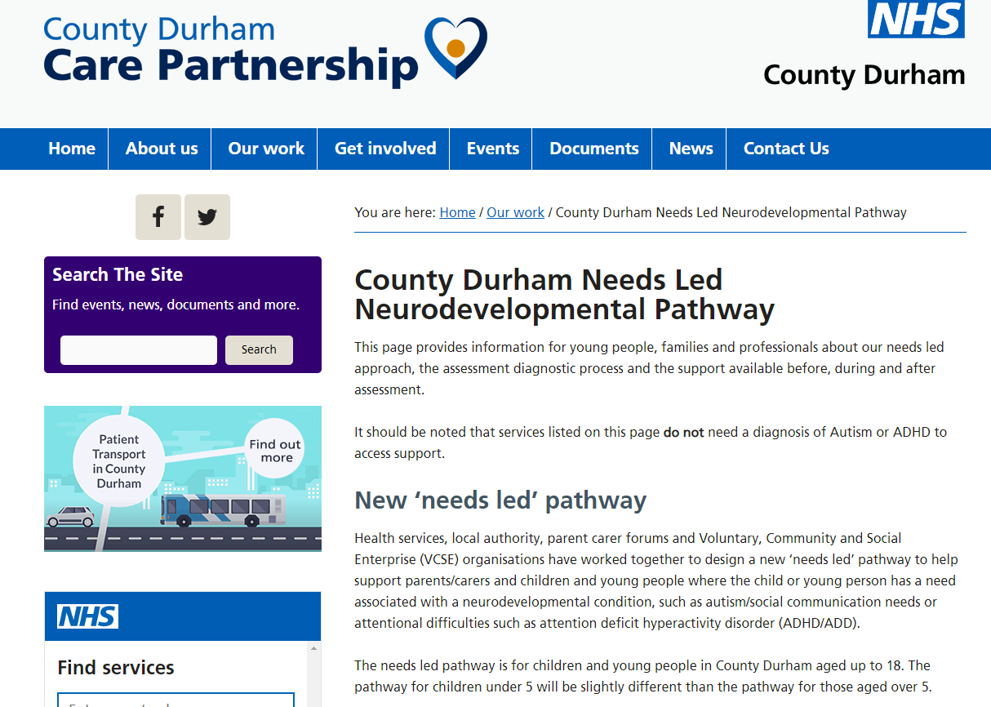
CCG Hosted Webpages
County Durham Needs Led Neurodevelopmental Pathway (icb.nhs.uk)
Darlington Needs Led Neurodevelopmental Pathway - NENC Tees Valley (icb.nhs.uk)

Slide 8
Challenges we are facing
Increased referral numbers
Additional referral screening and discussion
Increased demand for responding to queries from professionals and families
Development of a NICE compliant standardised single assessment pathway
Retention and recruitment of highly skilled clinicians – those who can diagnose autism/ADHD

Slide 9
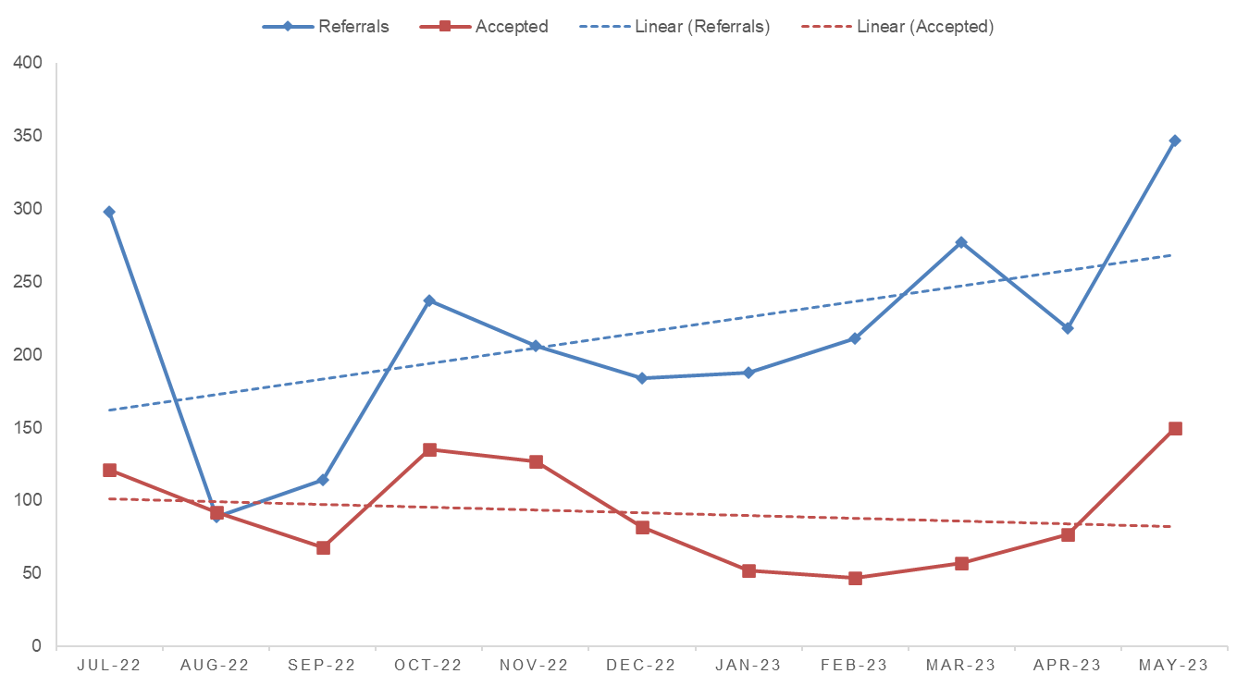
Referrals into the Service

Slide 10
What we’ve achieved so far
Go live dates:
Darlington 1st April 2021 and County Durham 4th October 2021
Multi-Agency panel to identify needs
Streamlined the referral process with speedier feedback
Local website for needs-led offer
Begun single assessments to consider both ADHD and Autism for some children and young people
Recruitment: expanded the team by over 30%

Slide 11
What we are working on
Partnership working to improve access to advice and information on what support is available, regardless of diagnosis by changing the “local offer” website.
Updating the Referral Form
Improving single neurodevelopmental assessment for all young people based on national guidelines and family feedback
Introducing a ‘neurodevelopmental key worker’ to guide families through their assessment journey
Individualised assessment planning aiming to improve outcomes
Recruitment and retention of staff – creative thinking across MH services
Communication – TEWV working ICB and service user and carer groups to improve this, reviewing the information that is sent out with suggestions of support that is available

Slide 12
Key Worker Model
Aims
To keep the child and family at the centre of the assessment
To be confident that the information we are using in our decision making is current and accurate
To reduce families having to retell their story
To use standardised paperwork
To reduce the number of appointments needed to make a decision
Ensure we are following a NICE compliant process
To streamline the process, and cut out unnecessary steps and assessment for the young person
Early indications suggest that this has a benefit for YP, family and staff

Slide 13
Assessment Process
Initial appointment with family and young person
Background information
Clinical impression
School information
Assessment planning meeting
Assessment appointments
Developmental history (1, 2 or more appointments)
Additional observations
Standardised assessments
Information gathering from other agencies (social care, mental health, health)

Slide 14
Further information / queries?
Rachael.allen13@nhs.net

