Slide 1
Transitions and Changes Learning Disability & Autism County Durham Study
Paula Meale - June 2023

Slide 2
BACKGROUND

Slide 3
Situation
Prevalence
County Durham has significantly higher prevalence of LD&/A than England in 2020. Only 23% of the projected LD&/A population can be found on GP registers, leaving 77% unaccounted for.
Populations are on the rising and ageing, in County Durham, residents with a LD&/A aged 65 or over is expected to grow by 27% between 2020 and 2035.
Healthy life expectancy (HLE) is lower still, males spend an average of 19 years and females 21.4 years in poor health. This is lower still in the LD&/A community.
HLE and ageing is an additional challenge for healthy living and independence for both individuals living with a LD&/ASD and those that care for them.

Slide 4
Situation
Wider Determinants of Health
Healthy Life Expectancy is linked to the wider determinants of health, there is evidence the LD&/A population are extremely affected by these.
Social isolation is common in the LD community; 77% are lonely, and 33% have no friends and fewer opportunities to make new connections.
Violence is an area of concern; prevalence of domestic abuse is greater for people living with a disability. Trends were also recorded in cases of sexual assault and hate crimes.
County Durham has one of the worst rates of unemployment among adults with learning impairments in England.

Slide 5
Situation
Care and Support
Many people in the LD&/ASD community, live with and are cared for by a family caregiver. Many care for that individual for more than 100 hours per week, and most have done so for over 20 years.
As people are living longer, an increased demand on services and growing complexity of needs is expected, which requires a deeper understanding of how care and support can and should be delivered in the future, to ensure people with LD&/ASDs live and age well in County Durham.

Slide 6
Ambition
What people who have a learning disability and/ or autism want and need to live well, including home and family life:
Communication and staying connected
The right support
To love and be loved
Have an effective voice
Employment and contribution
Better Lives and Good Lives Framework, 2021

Slide 7
Questions for the audience
Yes

Slide 8
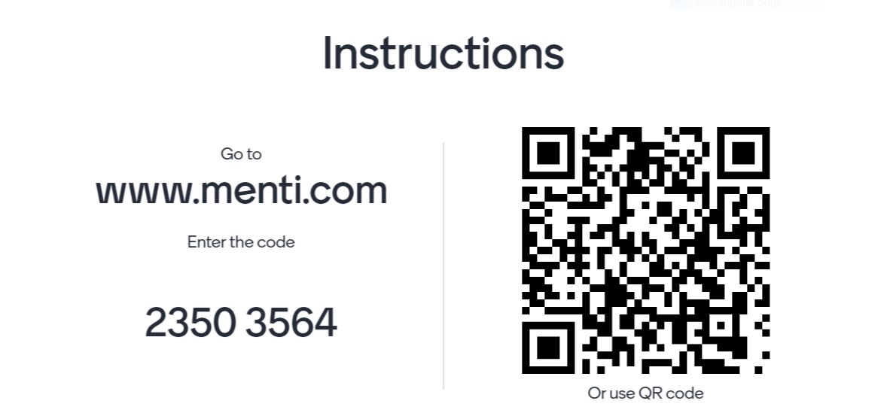

Slide 9
Ambition
What the UK government want people with a learning disability and/ autism to be able to say.
"I live an ordinary independent life in my community. I get high-quality treatment and support in the ways I want and need to live my life. I receive high-quality care and assistance in the ways that I want and need to live my life."
Building the Right Support for people with a learning disability and autistic people action plan, 2022

Slide 10
Questions for the audience
Yes

Slide 12
STUDY

Slide 13
What are we aiming to do?
To understand the support experiences of people who have a LD&/A, particularly but not exclusively during times of life transition
To discover areas of unmet need and find opportunities to improve support and experience
To decide the top support priorities, and create a solution led by and for persons with a LD&/ASD

Slide 14
Who do we want to talk to?
Study Population
Individuals with a learning disability &/ autism aged ≥ 16 years
Family members (aged ≥ 16 years) related to an individuals with a LD&/A who is aged ≥ 14 years
Professional providing specialist/ non-specialist services to individuals with a LD &/ or ASD aged ≥ 14 years

Slide 15
Who do we want to talk to?
Population
You
Individuals with a learning disability &/ autism aged ≥ 16 years
Family members (aged ≥ 16 years) related to an individuals with a LD&/A who is aged ≥ 14 years
Professional providing specialist/ non-specialist services to individuals with a LD &/ or ASD aged ≥ 14 years

Slide 16
We know life transitions are hard
School
Post Education
Support

Slide 17
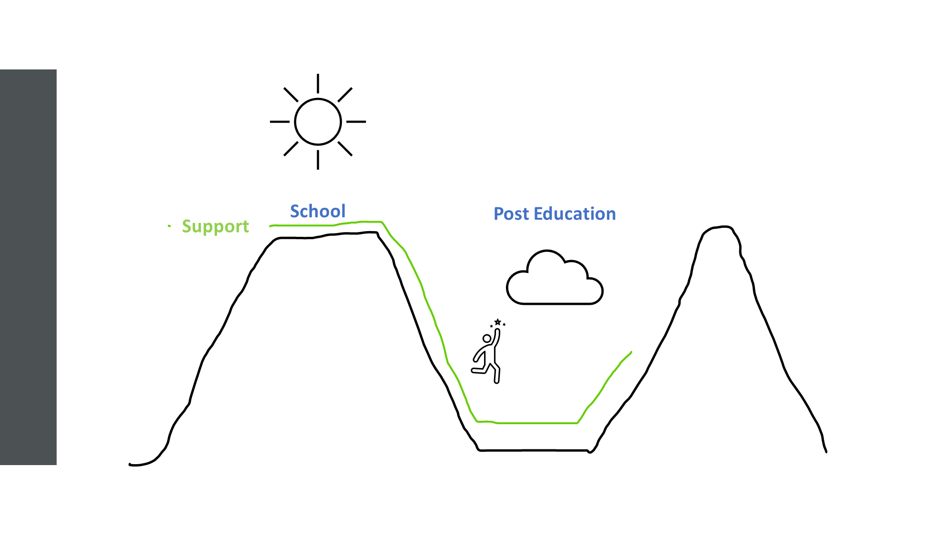
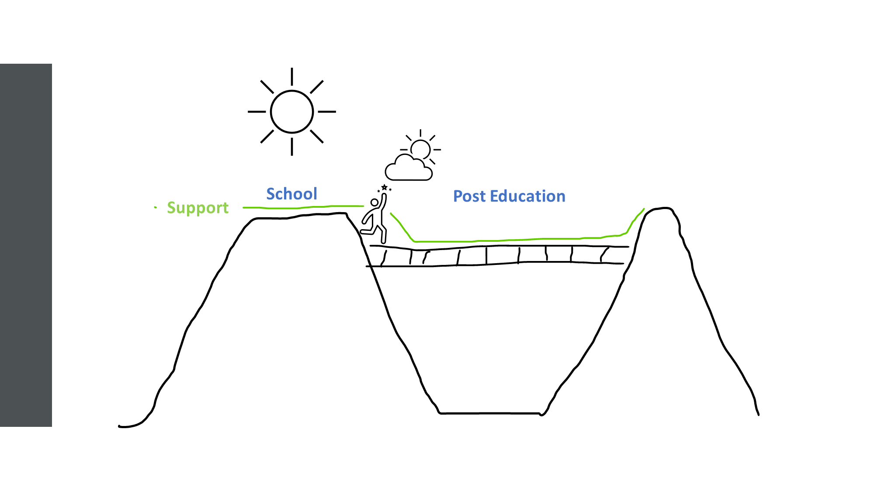
We need to know more
What is missing?
What would make life easier?
What is missing?
What would make things easier?

Slide 18
How to get involved?
Talk to us today
Contact us via research@pcp.uk.net
Encourage eligible people who have a learning disability and/ autism to take our survey
https://www.surveymonkey.co.uk/r/J9PPSY2

Slide 19
Questions

