Slide 1
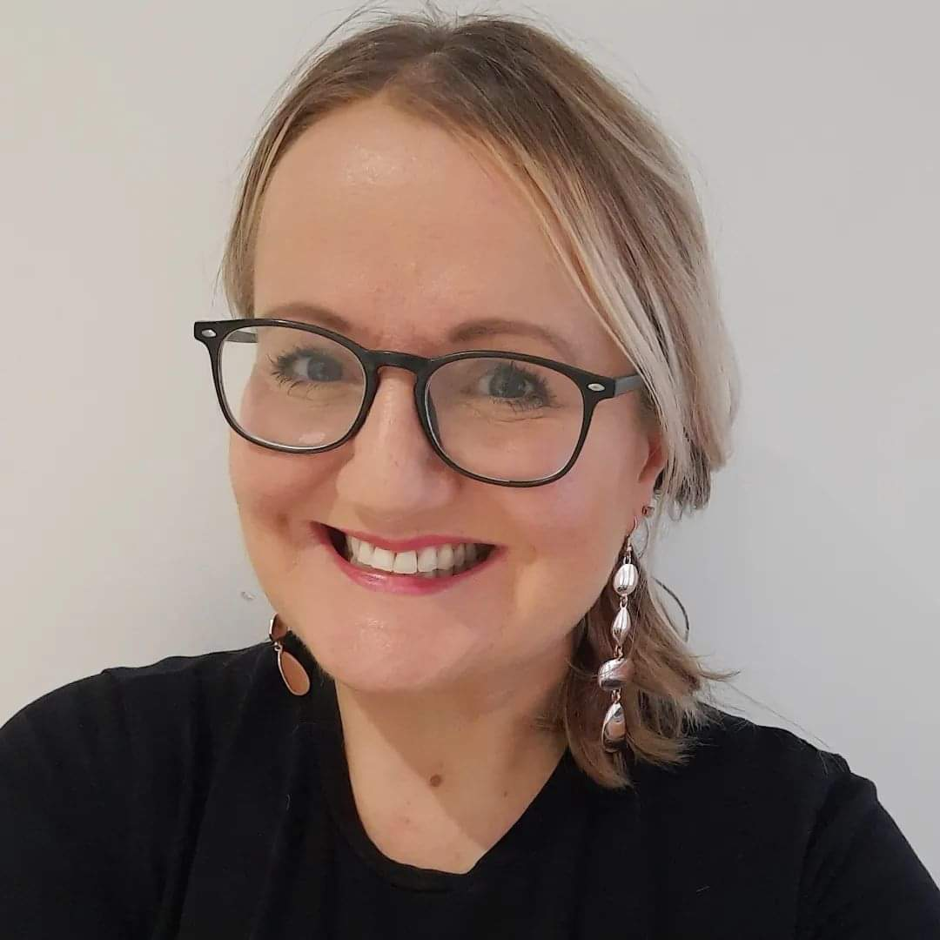
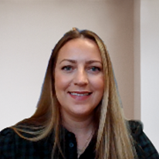
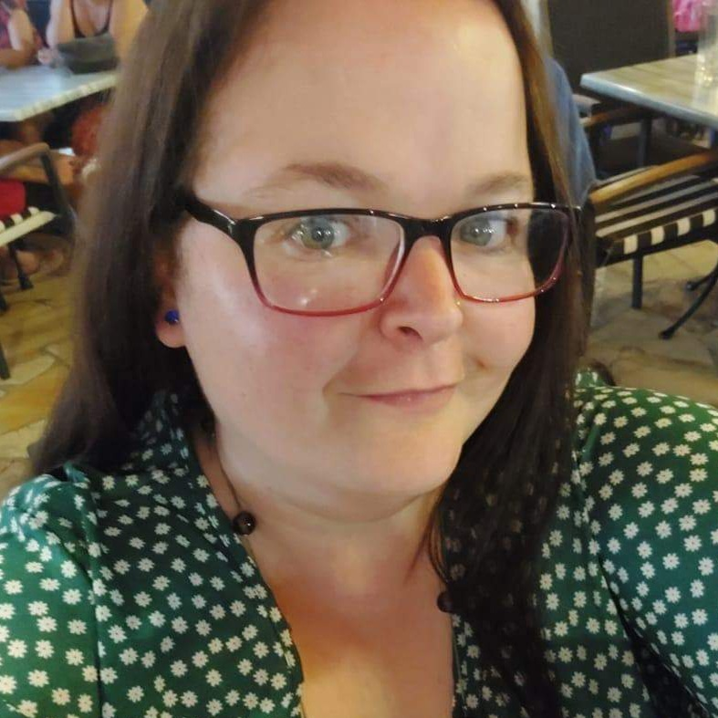
Short Breaks in County Durham
Lyndsey Dunn, Project Lead
Ruth Pope, Enabling Inclusive Communities Co-Ordinator
Danielle Pope, Short Breaks Solutions Officer
Sara Rawle – Parent / carer lead

Slide 2
We want: Parent/ carers of children/young people with SEN/D to be able to have a short break from caring when needed.

Slide 3
We want:
Opportunities that enable children and young people with disabilities to access their local community.
This Photo by Unknown Author is licensed under CC BY-NC-ND

Slide 4
Short break offer Advice, signposting and enabling access
• We provide funding to an external organisation, Durham County Carers Support, to work with parent carers to help understand what they need to support them in their caring role, including short breaks from caring and how these needs can be met. Parent carers can have a carers assessment completed as part of this service.
• We provide SEND Empowering Inclusive Communities (SENDEIC) who will work with families to help you develop a personalised response to meet your needs for a short break. This will include:
Providing information, signposting and developing potential solutions to meet individual needs. Help you find a suitable local community activity for your child/young person to access which will allow parent carers a short break from a caring role.
Working with parent carers who need a break from caring but are experiencing barriers in accessing a local community activity. We will work with you to personalise innovative, creative ways to help remove barriers, fill any gaps in provision and enable access where possible.

Slide 5
Current short break offer Additional support
• SENDEIC will work with families and organisations to develop local community activities with additional support for children/ young people who require this to enable them to take part in an activity to allow parent carers to have a short break from their caring role

Slide 6
Current short break offer Specialist support
• For families who feel they require more specialist support for children/young people with a range of complex needs that are unable to be met within the existing offer, they can access a statutory assessment to help identify unmet needs and work on potential solutions to meet these needs.

Slide 7
We have been working with families and a range of professionals to find out more about accessing the community and barriers
In response to this engagement, we are moving away from ‘short break solutions’ towards an approach to empower everyone to be part of the solution.
SEND Empowering Inclusive Communities (SENDEIC)
This is not just about supporting parent/ carers with solutions but to support wider communities to be part of this.
We have updated the Short Breaks Statement to reflect this approach and developed an animation working together with families to describe what a short break is and how this can be accessed.

Slide 8
SEND Empowering Inclusive Communities Partnership
Empowering Community Activity Providers
Empowering children and young people with SEND
Empowering parent carers
Empowering Community Facilities
Empowering Inclusive wider Community Cultures
Empowering Inclusive Community Travel

Slide 9
WATCH OUT FOR
SEND only Fun and Food – summer holidays
For families unable to access the existing community activities
Family trips outs
Supported families youth groups
Preparation and transition sessions
Virtual gaming session
Additional support social sessions e.g Gym, swimming, cinema
Supported physical activity sessions
Specialist small youth groups
Weekly family groups e.g Taekwondo, trampolining
This Photo by Unknown Author is licensed under CC BY-SA-NC
This Photo by Unknown Author is licensed under CC BY-SA

Slide 10
If you remember anything from this presentation, please remember to access the activities in the local community for children with special educational needs and/ or disabilities to allow you a short break.
Pop online and check out the updated short breaks statement.
Single starting point for contact - Telephone: 03000 260 270 or Email: SENDEIC@durham.gov.uk.
Register on Children and Young Peoples Network to receive regular updates.
We can work together to co-ordinate a creative response for families.

