Slide 1
MCT Conference 2023

Slide 2
Who are SENDIASS?
SENDIASS stands for Special Educational Needs and Disabilities, Information, Advice, Support Service
Durham SENDIASS are the statutory county wide service providing information, advice and support to:
Parents/ carers who have a child/ren or young people with SEND aged 0-25
Young people (16-25) with SEND
The IAS that we provide is governed by SEND law and legislation such as:
The Children and Families Act
The SEND CODE of Practice and SEND regulations
The service must be:
Confidential
Impartial
Work at arm’s length of the local authority

Slide 3
Common Reasons for Support 46% of all requests are from families who have a child on the Neurodevelopment Pathway
I am worried that my child’s school are not meeting their needs
How do I appeal sections of my child’s EHCP?
What can I do when my child has been refused an EHC Needs Assessment?
What can I do when my child with SEND is being excluded?
What can I do when my child can’t attend school due to anxiety and their mental health?
How will my child be supported at school?
How do I make a Parental Request for EHC Assessment ?
I am worried about my child’s transition (starting primary, secondary school or college)
What can I do when my child is not allow on a school trip?
How do I make a complaint about my child's education?
Can I have some support to prepare for a meeting with my child’s school?
What are my options for home educating my child?

Slide 4
Area of SEND Needs
Cognition & Learning 8%
Social, Emotional & Mental Health 49%
Communication & Interaction 41%
Physical and Sensory 3%
Neurodevelopmental Assessment Pathway 46%

Slide 5
How Many families have received support in 2022/23?
1044 existing cases which rolled over from 2022
673 new cases since January 2023
Currently working with over 1700 families

Slide 6
In 2021 SENDIASS proposed the development of a County Durham Neurodevelopmental Family Support Offer within the core provision of County Durham SENDIAS Service.

Slide 7
Who can access the offer?
The service is for families pre, during and post diagnosis for children and/or young people aged 0-25 if they:
Have concerns their child or young person may have Autism, ADHD, FASD or who display characteristics.
Are undergoing a Neurodevelopment Assessment.
Have a diagnosis of Autism/ADHD/FASD

Slide 8
What Support is available?
Access to a Neurodevelopmental Family Support Officer
1:1 telephone appointments
The Neurodevelopment Information Hub
Hub drop-in sessions and a SEND Roadshow planned for August
Workshops – restarting in September
Advice about education whilst on the neuropathway
Links to support for families in County Durham

Slide 9
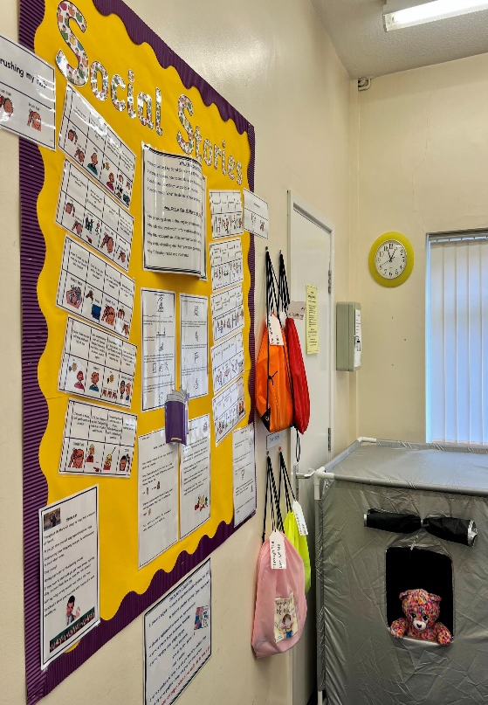
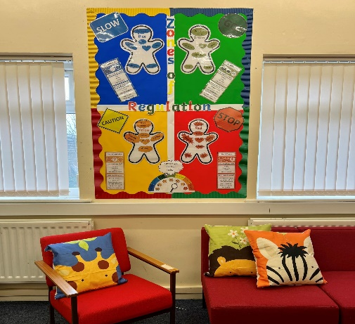
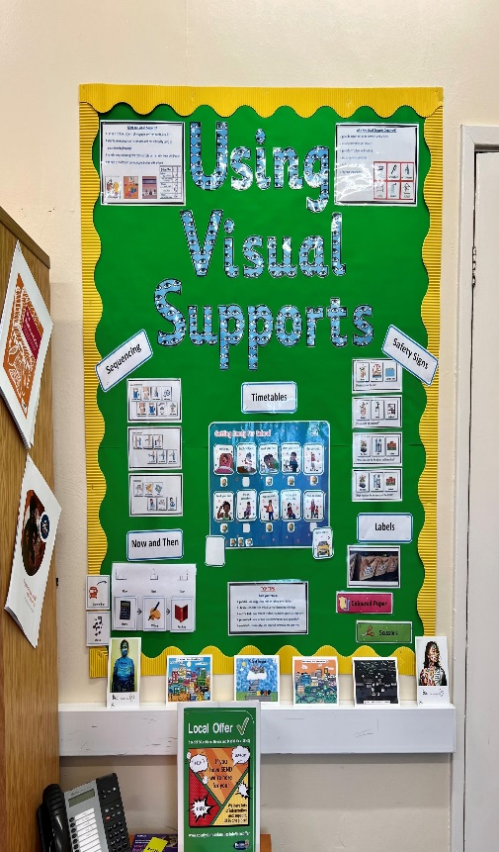
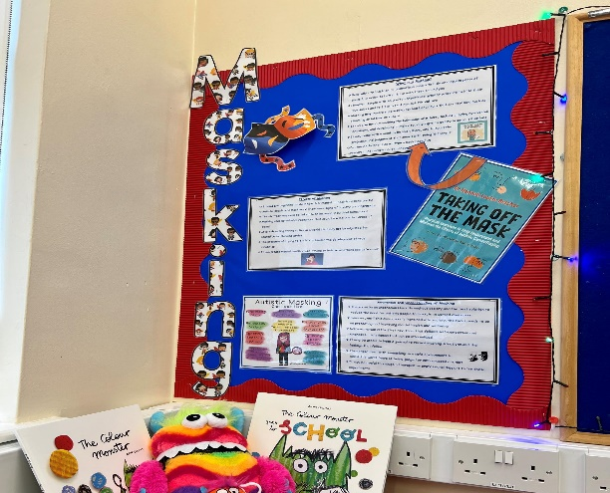
NEURODEVELOPMENTAL FAMILY SUPPORT OFFER UPDATE

Slide 10
Feedback from 2023
Many thanks for attending the meeting today, as always, your input was extremely valuable. You really helped clarify what we need too do about the EHCP, its guidance we really need.
The kids are starting school tomorrow and I just want to say thank you for helping me through the admission process, I am grateful.
I am so grateful for all of your help and advice; I couldn’t have done it without all that. Thank you from the bottom of my heart.
Thank you for the information, it is very useful, and I have passed it on to the relevant staff. Please can I say a huge thank you for your support yesterday.
Thank you, I really appreciated your call today as I was on tenterhooks awaiting what was happening and next move. Thank you again.
Thank you so much for your contribution to the coffee afternoon, it was great and very much appreciated and all very positive. Would you also pass on my thanks to your Short Breaks colleagues?

Slide 11
Feedback from families to develop the information, advice and support we offer.
What do SENDIASS do well?
What could SENDIASS do better?
Ideas for development?

Slide 12
Meet the TEAM
Lisa Kirton
SENDIASS Manager
Ann Connor
SENDIASS Triage Support Officer
Catherine Winn & Angela McGinlay
SENDIASS Officers
Christine Close and Kirsty Blake
Neurodevelopmental Family Support Officers
Ruth Pope
Enabling Inclusive Communities Co-ordinator
Danielle Pope
Inclusive Communities Coordinator

Slide 13
How to make a referral
Telephone: 0191 5873541 or 03000 267004 including 24 hours answer machine
Email: sendiass@durham.gov.uk
Website Contact Form
Professional Third Party referral form to be completed

