Slide 1
Improving Understanding of Sensory Issues
Claire Stirland MSc BSc (Hons) PgCert PgDip
Advanced Sensory Integration Practitioner
Specialist Occupational Therapist

Slide 2
Who are we?
Major Sensory and Developmental Therapy Service
Research
Understanding
Education
Sunderland University
Sheffield Hallam University
Ulster University
Sensory Integration Network UK
NHS England
How do we help?
Education
Supporting families
FASD based understanding
Trauma based understanding
Neurodevelopmental difference
Developmental interruption
Atypical developmental experience

Slide 3
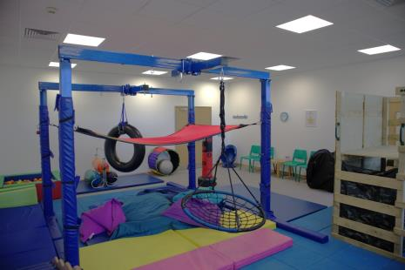
What do we help with?
Sensory reactivity (aka sensitivity)
Emotional regulation issues
‘Behavioural’ issues
Attention/concentration issues
Sleep issues
Eating/drinking issues
Toileting issues
Hygiene tolerance issues
Clothing tolerance
Controlling interaction
Social isolation
Poor change tolerance
Reliance on routine
Organisation skill difficulties
Transition difficulties
Eating non-food items
Mouthing non-food items
Chewing non-food items
Immature physical skills

Slide 4
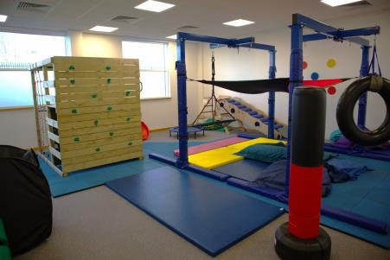
Who do we work with?
Families
Adults
Children
Schools
Organisations
Charities
Carers
Supported living
Day centres
Universities
NHS clinics
SEN teams

Slide 5
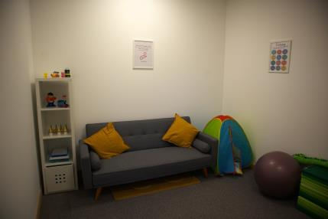
Assessments
Sensory
Sensory Integration
Dyspraxia
Visual perceptual
Praxis
Fine motor
Gross motor
Skill based
Play
School based
Home based

Slide 6
Therapy & Services
Short term or ongoing support
Sensory integration
Sensory regulation experiences
Emotional regulation & understanding
How are you? sessions
Social stories
Thoughts feelings and emotions sessions
Social skills
Tailored visuals packages
School engagement and support
Sensory yoga
Talking mats
Family support and mentoring
Group
Or
Individual

Slide 7
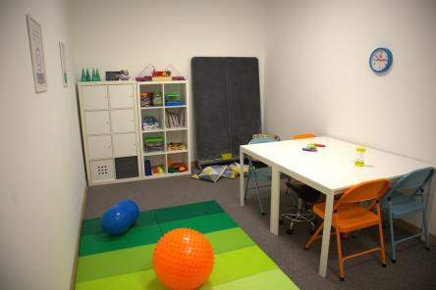
Coming up….
Holiday children’s group programmes:
Sensory Yoga
Sensory regulation
Movement development
Playing to write better
Social skills
Family support:
General family support group
Eating/drinking support group
Family information sessions
Making visuals
Therapy packages:
- Eating & drinking family support

Slide 8
Contact us
Refer to us directly
Ask us a question
Get information or advice

