Slide 2
Team Training is made up of :

Slide 3
A sad goodbye to one of our members
You may have heard about the changes taking effect from the end of June 23, Team Training would like to say a GREAT BIG THANK YOU to all of the Rollercoaster Team who have been part of Team Training and who have supported Team Training, you will be missed
This means that there is no longer a full on-line offer for Creative Education, some free session for parents and carers can be found on their website. https://www.creativeeducation.co.uk/courses-for-parents-and-carers/

Slide 4
Sessions offered since Nov 2022:
Transition from Education to Employment via Supported Employment
Challenging Behaviour
Calming an Angry Child
Better Sleep for Children with Additional Needs
Anxiety
Understanding Why Children Might Be Anxious About School
Access to the Creative Education Online Resources

Slide 5
Durham County Carers Support:
Feedback from DCCS workshops:
“Really helpful thanks, will try to keep my eyes open for any others [sessions] coming along.”
“Really informative session, really useful strategies and helpful to look through a child's perspective of how they feel in crisis and how to deal with situations without diving in.”
“Slides were clear and well delivered. Speaker was knowledgeable and friendly.”

Slide 6
Spotlight on CAMHS
“We have been offering online awareness sessions via MS Teams to parents and carers for over 2 years now. The sessions are facilitated by 2 CAMHS practitioners with many years of experience supported by our partners from Team Training most of whom have personal experience of many of the issues we are discussing.
We aim to offer a safe non-judgmental space where parents/carers can come and learn more about how to support the children and young people they care for. We offer conditional confidentiality in all sessions and ask that participants respect this and do not discuss anything other than general information and advice outside the call. Some participants are happy to share experiences while others prefer to observe and listen.”

Slide 7
Spotlight on CAMHS
“To come: a new presentation about Risk and Resilience. This will look at how we help our children to identify and manage risk and protective factors. It will also explore what Resilience is and how we can help our children and young people to build it and develop skills to manage adversity.
We also offer a portfolio of training for anyone working with children and young people in County Durham and Darlington. All training can be accessed via this link:
https://www.tewv.nhs.uk/get-involved/training/camhs-county-durham/ or by emailing TEWV.countydurhamcamhstraining@nhs.net”

Slide 8
Coming up from Team Training:
Emotional Wellbeing workshop in June - CAMHS
Anxiety 5-11 years workshop in July - CAMHS
Adolescent Sexual Development & Sexual Risk workshop in July - Forensic CAMHS
Child to Parent Violence & Aggression workshop in July - Forensic CAMHS
MCT & Sensory Worx are getting together for a little project – look out for more information on our website in the coming months.

Slide 9
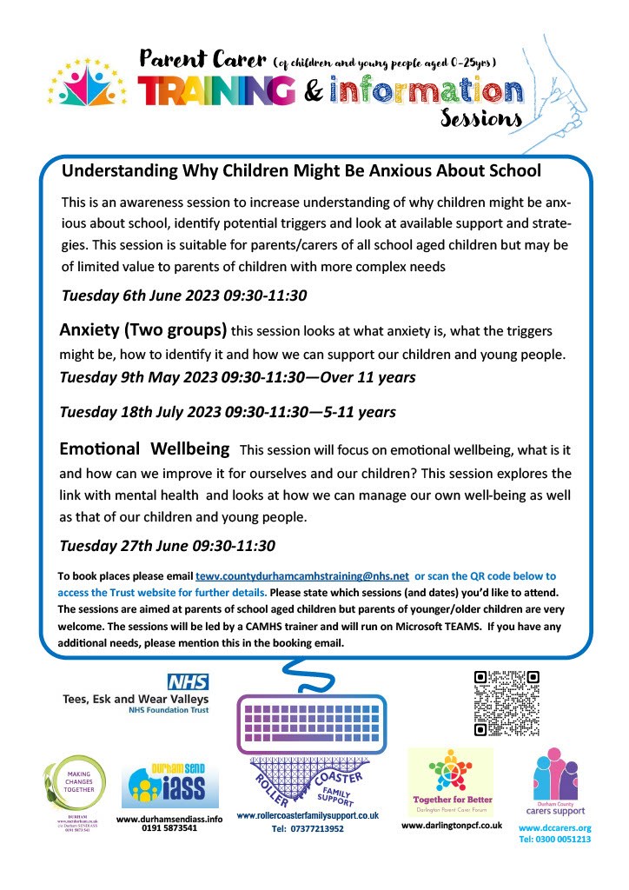
So, look out for Team Training Publicity on our social media platforms.
It will look like this….

Slide 10
Future Plans:
We would love to hear of any ideas you have for future sessions.
There is a sheet in your pack for you to complete now, these sheets are shared with all members of Team Training and help us identify parent carer training needs.

Slide 11
You can contact any of the following organisations through our social media platforms or website.
www.mctdurham.co.uk
www.dccarers.org Tel: 0300 0051213
Tel: 0191 5873542 or 03000 267 007
https://durhamsendiass.info/

