Slide 2
Children and young people possess the same rights as the rest of humanity.
Young people experience a better quality of life in society in general terms.
The services they access recognise and respect their human rights.

Slide 3
IiC creates opportunities for children and young people to become genuine participants in decision making processes
IiC works with a range of organisations to promote and engage in dialogue with children, which leads to real change
We provide a platform for children and young people to share their ideas for creative and supportive projects.

Slide 5
Language of Autism
Your Autism
SEND Promise
Transport
Leisure
Key messages for social workers

Slide 6
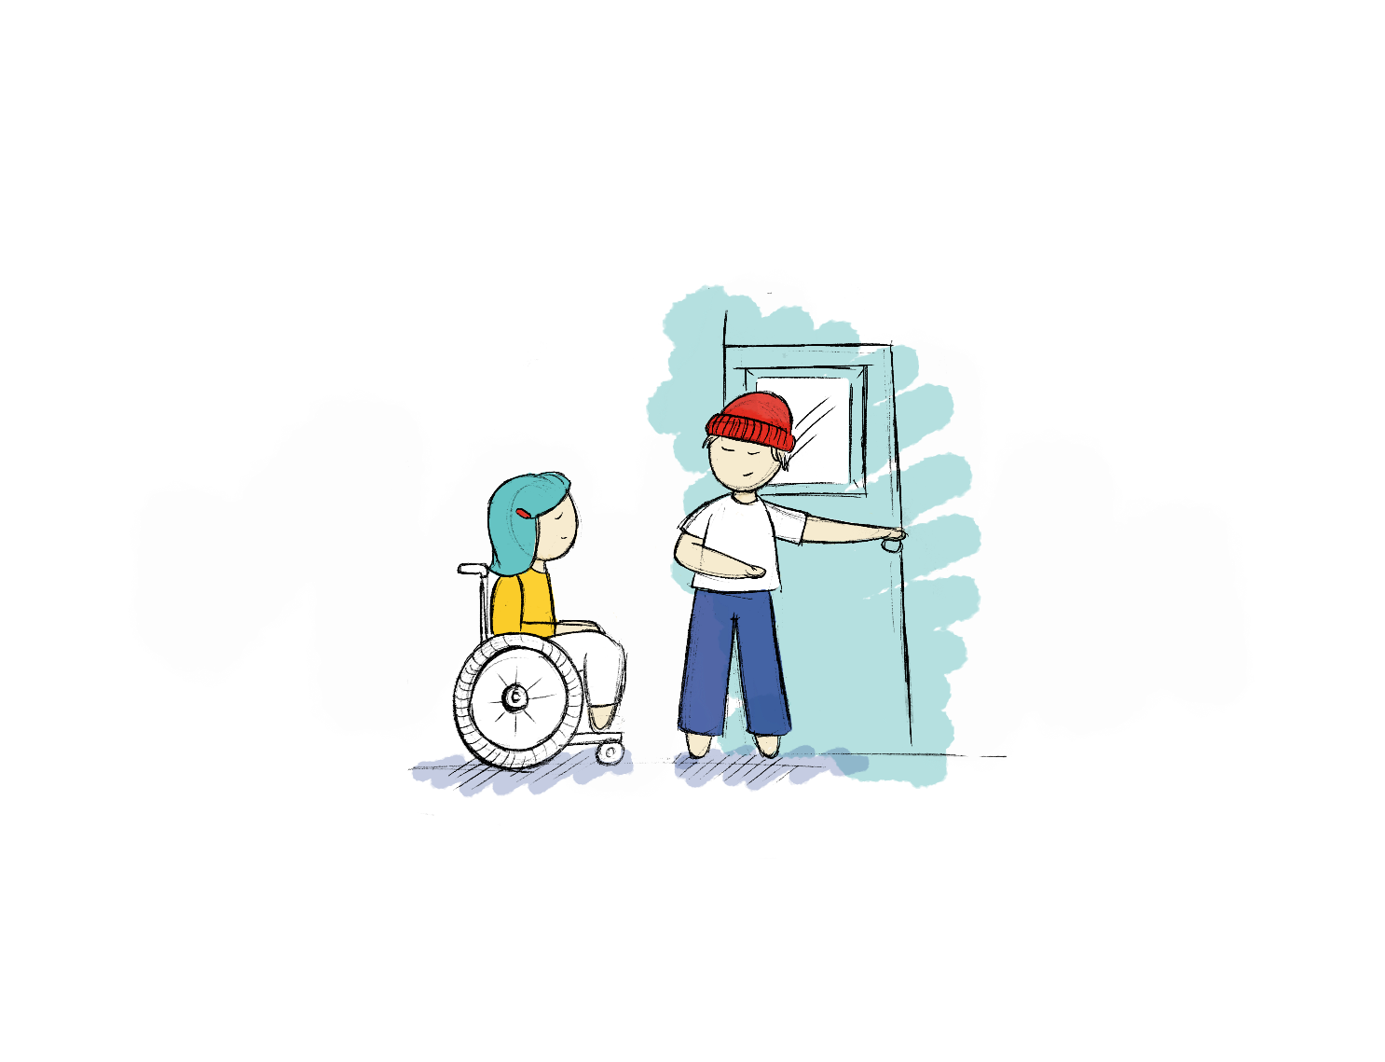
Find out more or get in touch: info@investinginchildren.net
0191 307 7030
https://investinginchildren.net/
https://yourautism.co.uk/

