Slide 1
County Durham and Darlington Needs Led Neurodevelopmental Pathway
Sara Chadwick, Speech and Language Therapist
Tees, Esk & Wear Valleys NHS FT
Sarah Watson, Clinical Nurse Specialist,
Tees, Esk & Wear Valleys NHS FT

Slide 2
Needs Led ‘Offer’
Information brought together for the local area
Some additional funding available to minimise ‘gaps’ identified
Emphasis on support and advice being available regardless of diagnosis
County Durham's Families Information Service | Search results (countydurhamfamilies.info)

Slide 3
County Durham Needs Led Pathway

Slide 4
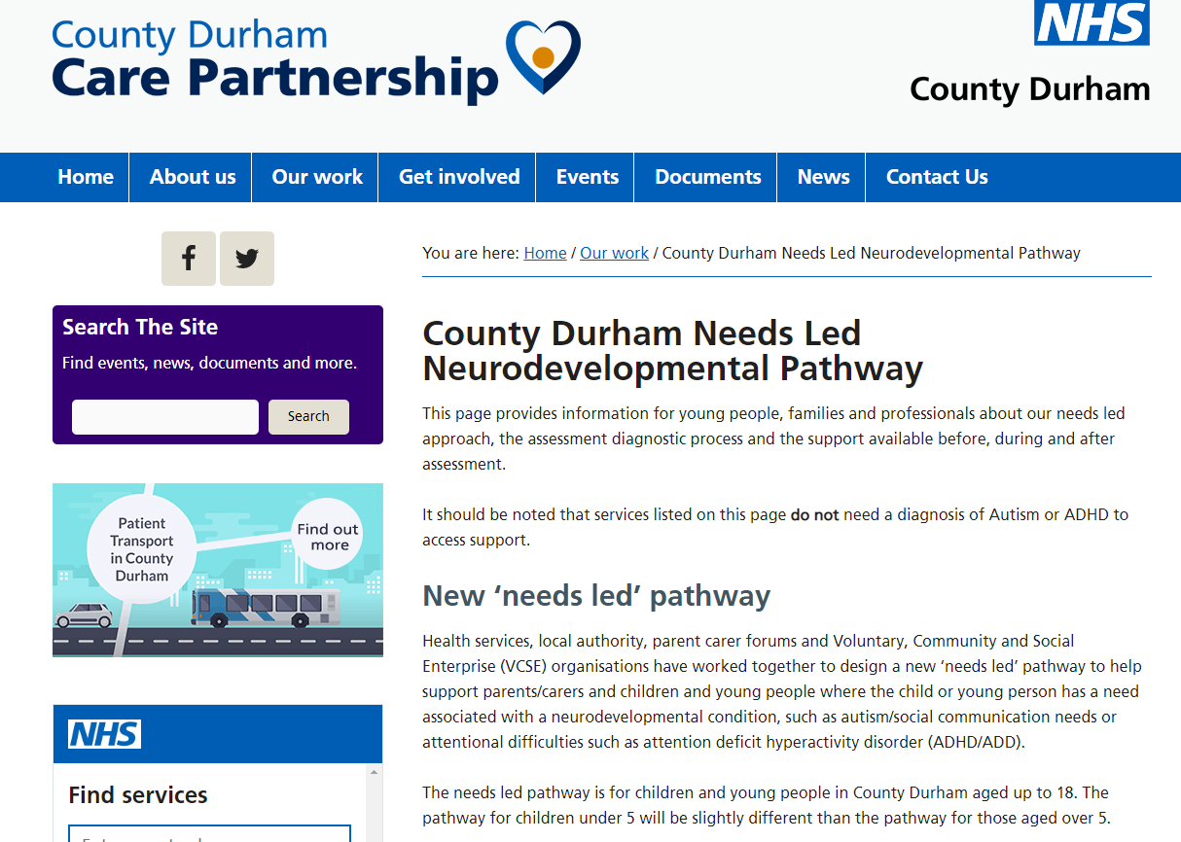
CCG Hosted Webpages
County Durham Needs Led Neurodevelopmental Pathway (icb.nhs.uk)
Darlington Needs Led Neurodevelopmental Pathway - NENC Tees Valley (icb.nhs.uk)

Slide 5
What’s happening
Consett pilot – improved liaison with parents and schools at the earliest point, before and after referral.
Ongoing review of 0-5 pathway.
Improving single neurodevelopmental assessment for all young people based on national guidelines and family feedback
Neurodevelopmental key worker to guide families through their assessment journey
Individualised assessment planning aiming to improve outcomes
Recruiting staff to support capacity. Although there are still capacity challenges.
Reviewing the information that is sent out with suggestions of support available. Increased Daisy Chain offer.

Slide 6
What we are working on
Partnership working to improve access to advice and information on what support is available, regardless of diagnosis.
Better liaison with adult services to ensure transition between teams as appropriate.
Improving the 0-5s and early school age pathway with partner agencies.
Updating the Referral Form

Slide 7
Assessment Process
Initial appointment with family and young person
Background information
Clinical impression
School information
Assessment planning meeting
Assessment appointments
Developmental history (1, 2 or more appointments)
Additional observations
Standardised assessments
Information gathering from other agencies (social care, mental health, health)

Slide 8
Key Worker Model
Aims
To keep the child and family at the centre of the assessment
To be confident that the information we are using in our decision making is current and accurate
To reduce families having to retell their story
To use standardised paperwork
To reduce the number of appointments needed to make a decision
Ensure we are following a NICE compliant process
To streamline the process, and cut out unnecessary steps and assessment for the young person

Slide 9
What’s next?

Slide 10
Further information / queries?
Rachael.allen13@nhs.net

