Slide 2
Team Training is made up of :

Slide 3
Sessions offered since June 2023:
Understanding Sleep
Understanding Behaviour Development in Children & Young People
Understanding Why Children Might Be Anxious About School
Anxiety
Emotional Wellbeing

Slide 4
Coming up from Team Training:
Wednesday 6th December - Child to Parent Violence & Aggression - CAMHS
CAMHS plan to have more workshops on offer in the new year.

Slide 5
SENDIASS aim to offer some workshops in the spring.
They are currently doing monthly SENDIASS drop-in sessions at each of the 15 family hubs and a fortnightly online drop-in session.
MCT & Sensory Worx are working on a leaflet for parents and carers about how a child is impacted from a sensory perspective.

Slide 7
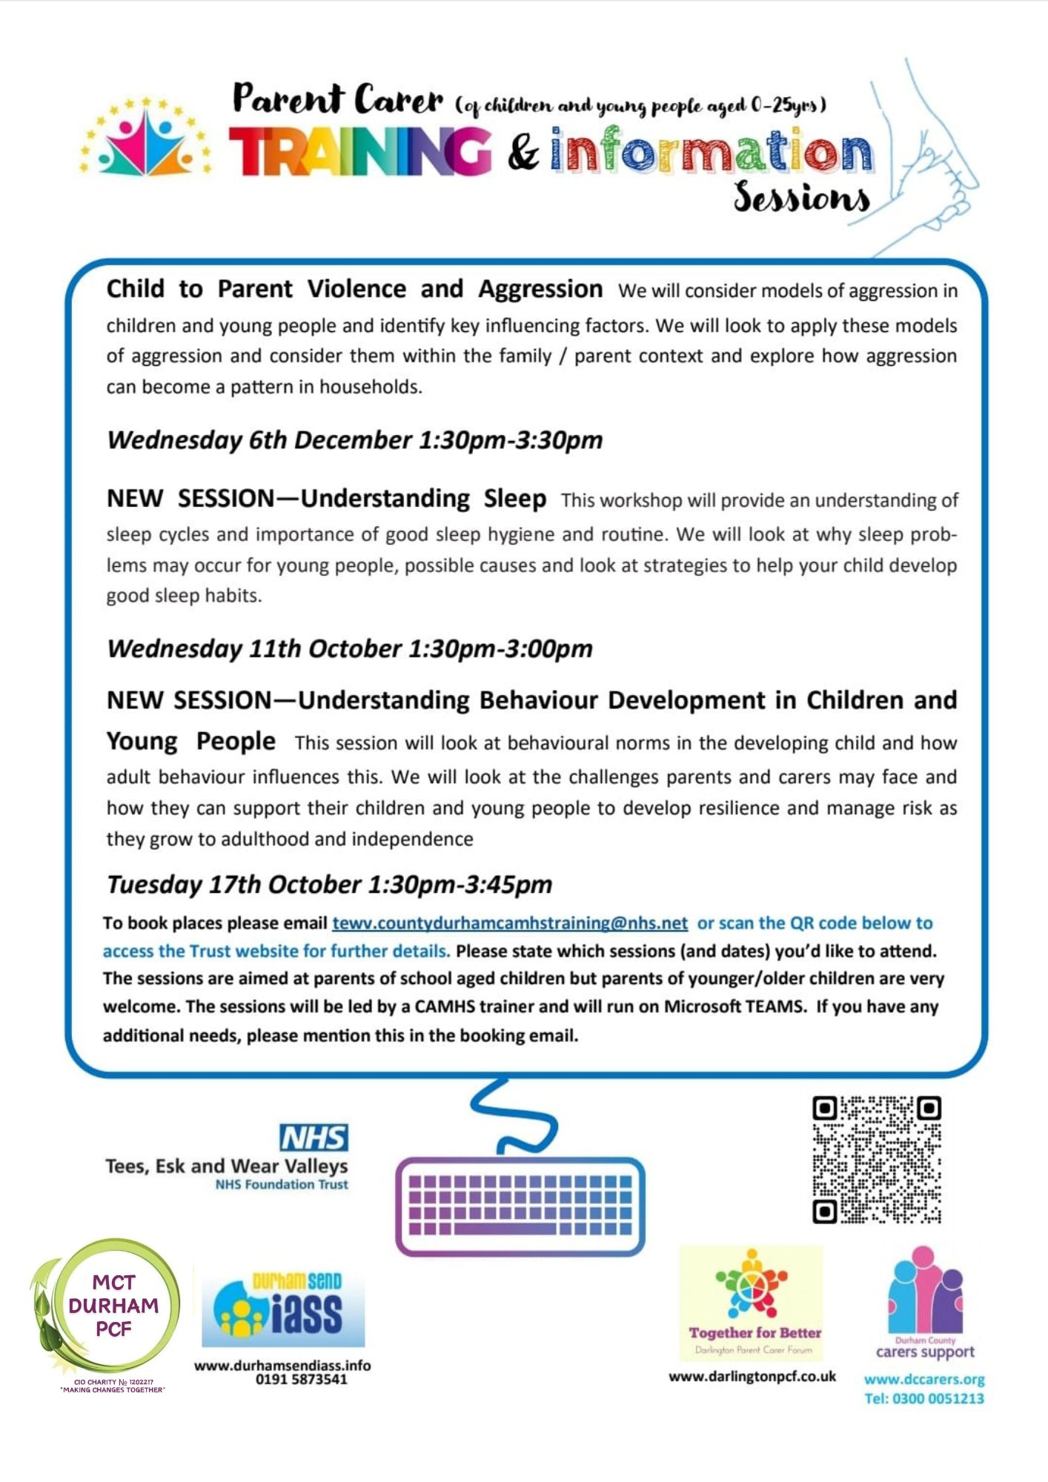
So, look out for Team Training Publicity on our social media platforms.
It will look like this….

Slide 8
Future Plans:
We would love to hear of any ideas you have for future sessions.
There is a sheet in your pack for you to complete now, these sheets are shared with all members of Team Training and help us identify parent carer training needs.

Slide 9
You can contact any of the following organisations through our social media platforms or website.
www.mctdurham.co.uk
www.dccarers.org
Tel: 0300 0051213
Tel: 0191 5873542 or 03000 267 007
https://durhamsendiass.info/

