Slide 1

SENDIASS – Information, Advice, Support Officer (Autism Spectrum Condition and Social Communication Difficulties)
Heidi Donkin
Notes:
Good Morning / Afternoon – Thank you for taking the time to attend MCT virtual conference. My name is Heidi Donkin and I am new to the SENDIASS team in Durham. I have been appointed to a newly created post to enhance the offer of support that SENDIASS already have whilst focusing on helping families with children and young people with autism or social communication difficulties with or without a diagnosis in County Durham.

Slide 2
Special Educational Needs and Disability Information, Advice and Support Service

Slide 3
The SENDIASS Team – what we offer…
A dedicated telephone helpline, email, 1:1 telephone or virtual appointments.
Listen to families views and concerns.
Work with families to explore their options
Support to promote effective communication
Preparation for meetings
The graduated approach to SEND
Help with written information
Health and Social Care Provisions
SEND Mediation, Appeals and Tribunal
The Local Offer & Signposting
SEND Training Workshops
Notes:
The SENDIASS Team in Durham are a well established team and offer support and advice in numerous ways already which I will briefly recap on incase anyone joining us today is unfamiliar with the team.
1) Offer a dedicated telephone helpline, email correspondence, telephone call back appointments and virtual appointments (some families like to have a face to face discussion and the virtual world has really opened the way we engage with families).
2) Families contact SENDIASS because they are unhappy, frustrated, misled, overwhelmed or unsure. We must in confidence listen to the views and concerns of families and offer impartial support to resolve their dispute or dissatisfaction.
3) We work with families to explore their options by offering accurate information and advice that is legally based within the SEND code of practice. Our role is to enable families to make informed decisions, know their options and what to do next.
4) Work to promote effective communication between the family and the setting, services and the LA.
5) Offer practical support families to prepare for meetings, to be confident to express their views and wishes.
6) Offer information to help families understand and have confidence in the graduated support to SEND including SEN Support Plans, funding, Statutory Assessment and EHCP. Families tell is it can still be a complicated and overwhelming process for them and they need to know what this means for their child.
7) Support with written information including parental request for an EHCP assessment, parental views, young persons views and wishes.
8) Information about health and social care provisions for children and young people with SEND.
9) Advice and support regarding SEND Appeals including forms and written preparation and we can be asked to go with a family to a tribunal.
10) Information about using the local offer as well as signposting to support that is available across County Durham.
12) Offer SEND workshops for parents and Carers: How my child is support in school, SEND & the LAW, Exclusions, A Parents Toolkit to SEND, Statutory Assessment & EHCP’s, Transitions.

Slide 4
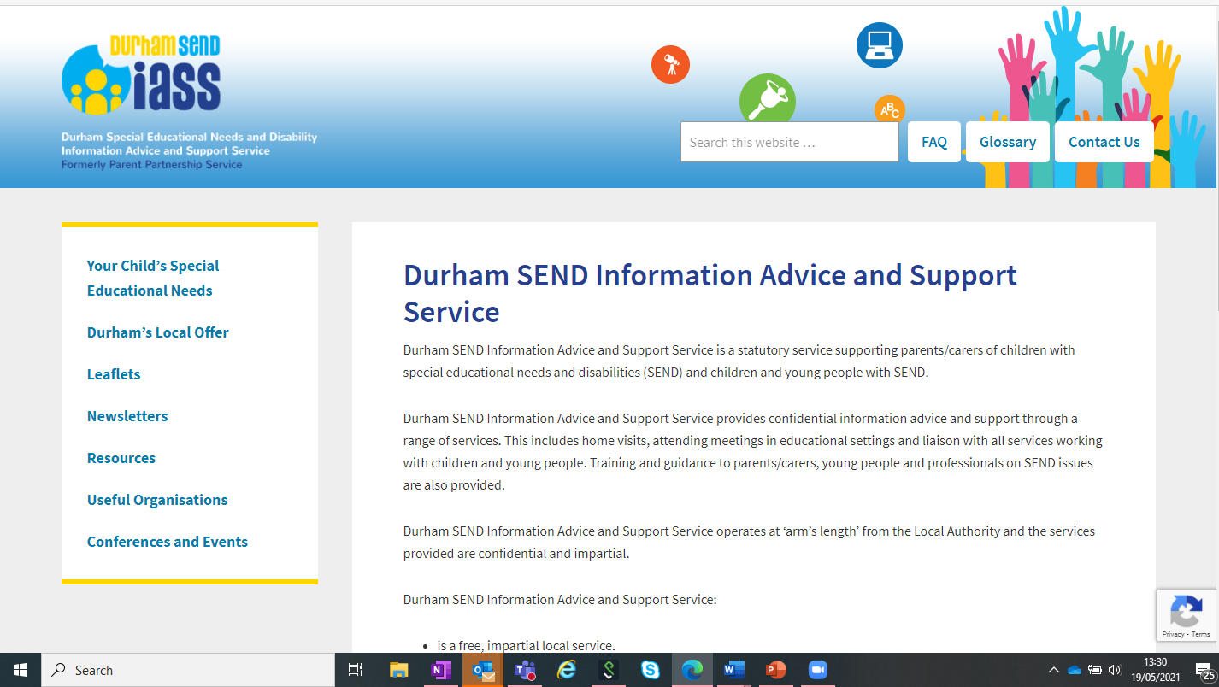
https://durhamsendiass.info

Slide 5
Information, Advice, Support Officer (Autism Spectrum Condition and Social Communication Difficulties)
Clear and effective communication of information, help and support for families who have a child or young person (up to 25) with Autism or Social communication difficulties with or without a diagnosis.
Based within the SENDIASS team
Central point of contact for families to access support and advice.
Helping families to build their own skills, knowledge and resilience.
Supporting families to gain understanding and information.
Work with families to understand barriers and identify gaps or duplications in local services.
Notes:
My new role has been commissioned with objectives in mind to support families of children and young people within county durham with autism or social communication difficulties. This support is available regardless of whether there is a diagnosis in place or not.
I am developing the role within the team to offer a central point of contact for families to access support, advice and signpositing to services within the local area
I hope to support families to build their own skills and knowledge and to help develop better understanding of autism and communication difficulties. I aim to create resilience and strengthen parents and carers so they can make the best choices for their children and YP.
Alongside families and services like MCT parent forum, I hope we can learn more around the barriers and challenges that face families and use this information to find gaps or duplications in services to further enhance support within co durham.

Slide 6
Role development – coming soon….
Setting up a virtual Autism hub for County Durham – website linked to SENDIASS / Local Offer
A physical Autism Hub – a place to come and get support face to face
Support offered during assessment process and afterwards – in development alongside the Neurodevelopmental pathway team.
Training offer to be developed
Social media presence – SENDIASS coming soon…
Coffee mornings and workshops with partner agencies
Drop in sessions in different locality areas
Notes:
I have lots of exciting ideas that I would like to develop in Co Durham to support families. These include:
Setting up a website that is linked to the SENDIASS page and the Local offer where families can access information and advice as a central point. This will be the Durham Autism Hub and will have lots of useful information, advice, activities and support located in one place which makes it easier to access and find.
When restrictions are lifted and we are allowed to move forward from lock down, we are hoping to set up a physical hub in Durham. A room where you can come to find information and attend drop in sessions and coffee mornings. Once we have this set up and an idea of how this will look and run, we will then look at using different buildings in co durham to host drop in sessions to access support in all areas of county durham and not just in one area.
We are working alongside the neurodevelopmental pathway team to look at how support can be offered to families during the assessment process and afterwards.
We would like to be able to run coffee mornings and workshops with partner agencies for families and carers to attend.
I hope that through forums such as MCT we are able to work together to identify gaps in services and support and look for ways to fill these and offer the support that is needed to families at the right time in the right way.
There are lots of exciting developments to look forward to so please watch this space and I look forward to being able to keep you all updated as the journey and the role develops further.

Slide 7
Heidi Donkin - IASS Officer for Autism and Communication Difficulties
SENDIASS
Heidi.Donkin@durham.gov.uk
03000264484
Durham SENDIASS Team
Helpline: 0191 5873541
Email: sendiass@durham.gov.uk
Website: www.durhamsendiass.info
Notes:
As always, if you are a family, parent carer or young person and you feel that you could use some support from SENDIASS, please contact the team helpline on 01915873541 or email us on sendiass@durham.gov.uk.
Thank you for your time today and I hope you enjoy listening to the rest of the speakers here today.
Thank you.

