Slide 1
Notes:
Introduction

Slide 2
Making Time4Calm
What is Mindfulness?
Noticing the ‘Monkey Mind’
What can we do quieten it?
Our inner Meercat
Reflections
Biggest Takeaway from Today

Slide 3
The Monkey Mind
https://youtu.be/alyapidLB34
Notes:
Without judgement just ask yourself Are you still present ? Did you notice where your thoughts wandered to? What problems does it cause?

Slide 4
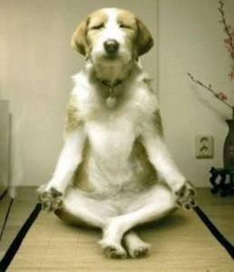
Constantly being interrupted by external distractions has literally caused our mind to jump around like crazy monkeys, preventing us from paying attention to what is happening now.
Notes:
Let’s notice what our mind is like by just sitting still for 10 mins.

Slide 5
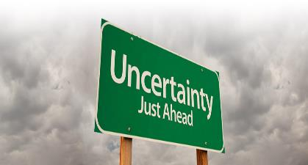
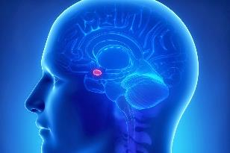
What causes us to overreact? Over thinking!

Slide 6
The 3 Key Elements for making Time4Calm 1. Mindfulness is an attitude and a way of BEING that cultivates a stronger connection to the present moment and surroundings by using all your senses without any judgment. (Listening) 2. Meditation is the practice that can train you to develop mindfulness. (Connects mind and body) 3. Positive reflections re-trains our mind to focus on the good we already have in our life. (Gratitude)
Notes:
At home everyday practice these 3 elements. 1) chose one daily activity to completely focus on 2) for 10 minutes sit and practice formal meditation, if you need a guide please consider downloading a meditation app on your smart phone such as Headspace or check out one from the Mindfulness Association of which I am a member.

Slide 7
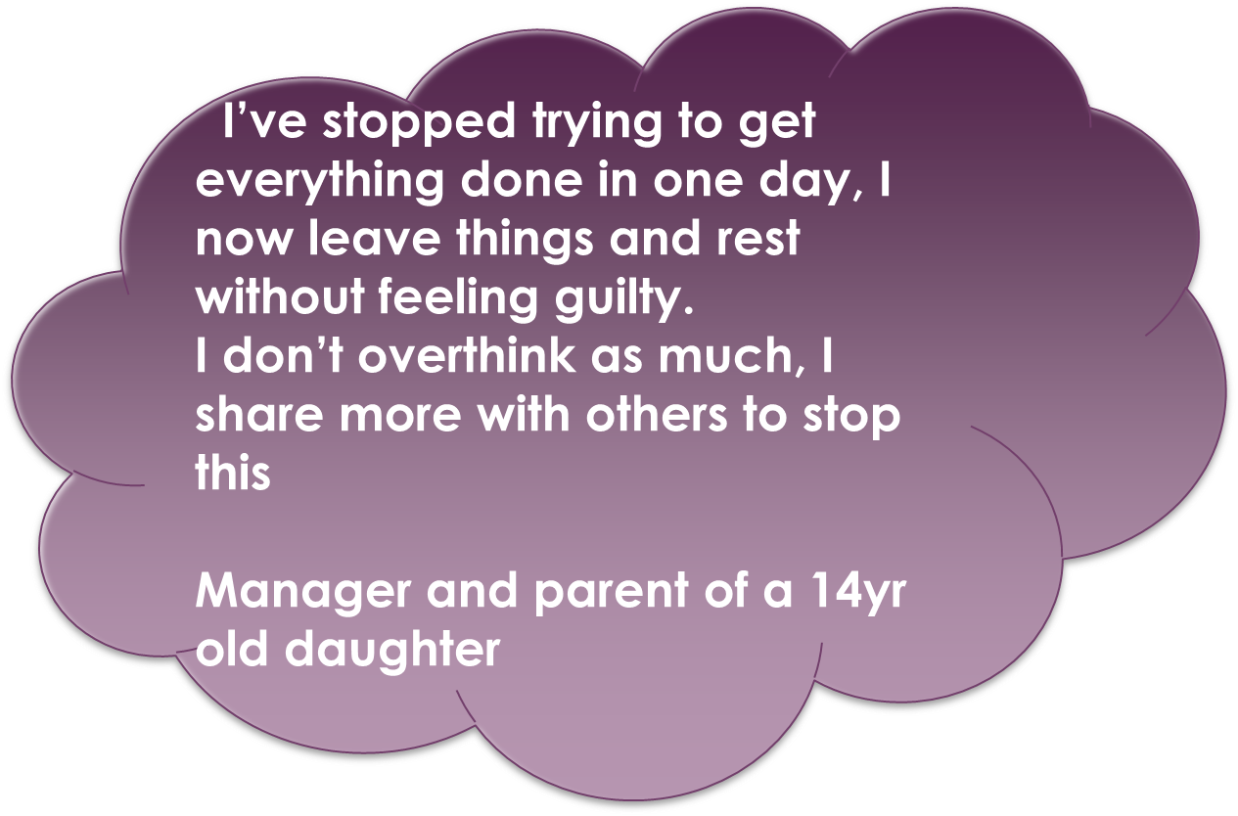
Notes:
What others have said after practicing the 3 elements of Time4Calm

Slide 8
The practice has helped me stay calm during rush hour. Now instead of getting road rage, I just focus on the car radio and listen to the music, I just don’t waste my energy in anger, I’ve learnt to let go.
Customer Service Officer and parent of a toddler
Notes:
Write down some situations in your life you’d like to deal with calmly, for example when you’re in a hurry and stuck in a queue? or when it’s your turn to answer a question? Or when your about to have an interview?

Slide 9
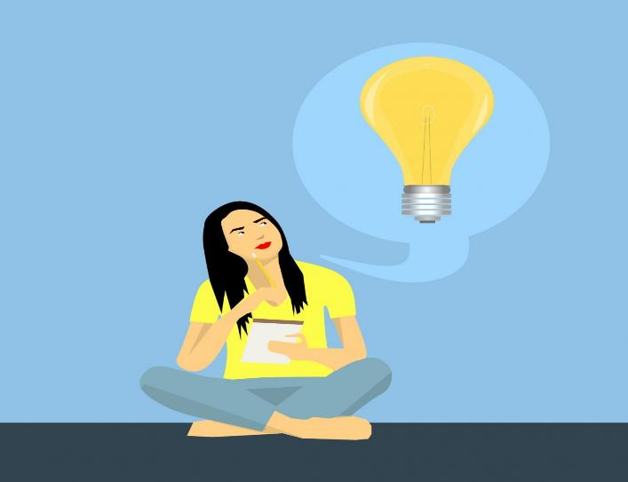
Biggest Takeaway From Today?
Notes:
Positive Reflections reminds the mind of the good in our life … what 1 important message are you taking in from today’s conference
Searching for the positive reduces our automatic negative self talk and re-trains the brain to learn from experiences and let go of negative thinking habits. If you’ve noticed your brain does ‘err’ on the negative, just notice without judgement and remember it’s a developed habit in the brain that’s causing automatic reactions. Lets practice searching for the positive and write down 3 things you are grateful for right now

Slide 10
Make Time4Calm with Daily Practice

