Slide 1
Transitioning into Adult Mental Health Services

Slide 2

Finally becoming an adult is exciting but can also be a little scary……….
You can vote
Stand for election as an MP/mayor
Buy fireworks
Place a bet
Drink alcohol
Drive a bus
Buy a lottery ticket
Get a tattoo
Become a blood donor

Slide 3
What if you need to continue to require care and treatment for your mental health?
Early intervention is better.
AMH can engage with you up to six months before you become 18
We can undertake joint visits with your care team
During this time we will talk with you and your care team
We want to help you with your recovery

Slide 4
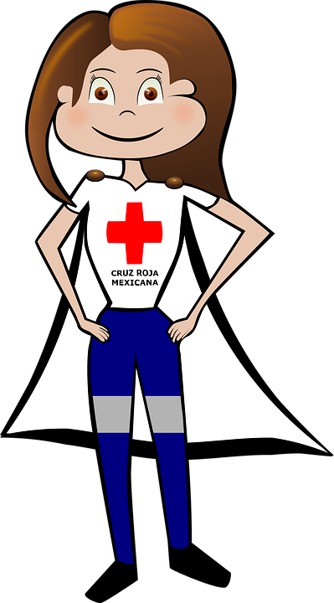
What to expect
Honesty & transparency
Confidentiality
Specialised assessment
Collaborative working

Slide 5
The Community Mental Health Team
Once you have been referred to adult mental health services you will be allocated to a Community Mental Health Team. (CMHT)
Working within a CMHT are a variety of health professionals nurse’s, social workers, psychologists, doctors. They often meet up to review people’s treatment , care and progress.
The CMHT team manager will allocate a care co-ordinator (usually a nurse or a social worker) to work closely with you and help manage your care !

Slide 6
Allocation of a care co-ordinator
Regular appointments
Medication review
Access to therapies
Support and sign posting

Slide 7

The role of the Care Co-ordinator
To work collaboratively with you to plan your care.
Help you to develop your care plan
Signpost when appropriate
Deliver interventions
Assess and manage risk
Communicate

Slide 8
Families
You have a right to expect confidentiality from services.
You can choose who you share your information with
We want to work inclusively with you and your family, but this is your choice!

Slide 9

What else can we do ?
By working collaboratively we can
Promote Independence
Aid recovery
Offer hope
Let your hopes, not your hurts, shape your future.”

