Slide 1


Service Update for the
MCT Conference XXVI

Slide 2
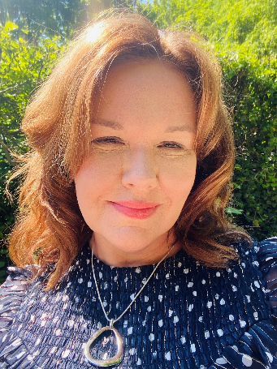
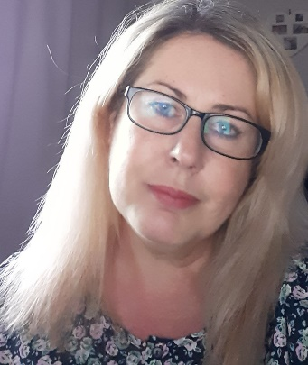

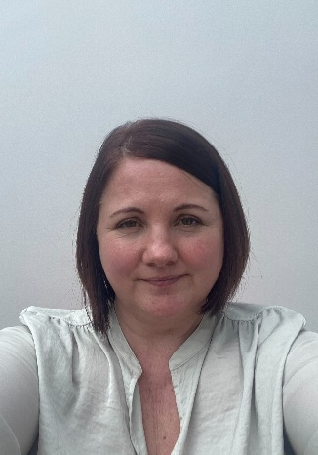
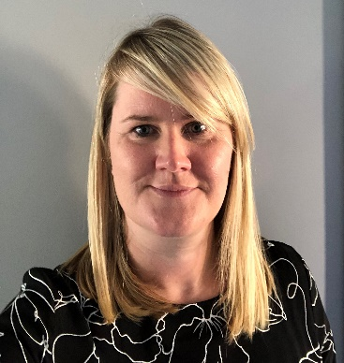
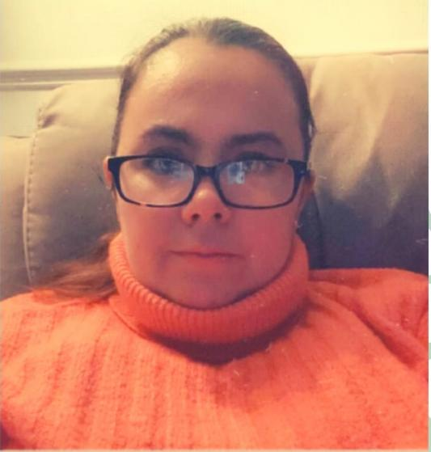
Who’s Who?
Lisa Kirton Ann Connor Ruth Pope
SENDIASS Coordinator SENDIASS Support Officer Short Break Solutions Officer
Catherine Winn Angela McGinlay Heidi Donkin
IASS Officer (SEND) IASS Officer (SEND) IASS (Autism & Social Communication)

Slide 3
Review of SENDIASS Data so far in 2021
So far in 2021 SENDIASS have received over 4500 enquires from parents, carers and professionals.
84% of enquiries were made directly by parents or a supporting family member.
96% of families have a child attending a mainstream provision.
63% of enquiries were in relation to a lack confidence or understanding of their child’s SEND provision.
79% of enquiries were from families who have children with Communication and Interaction difficulties with 33% of those who have associated SEMH needs including anxiety, emotional well-being and mental health.
44% of enquiries related to parental requests for statutory assessment for an EHCP.
103 families received impartial guidance and support with the SENDIST Appeal process.
Notes:
Housekeeping arrangements
Briefly mention the session format
Can speak at end if needed.

Slide 4
New Role for families
In April 2020 we welcomed Heidi Donkin to our team. Heidi’s post is to service to support families who have children or young people with Autism or Social Communication Difficulties with or without a diagnosis. The aim of the role is to empower families to build their own skills, knowledge, and resilience to be able to make their own choices to understand and support their child.
She has also been working closely with colleagues regarding the launch of the Neurodevelopment Pathway.
She has been closely involved with the development of Parent/Carers Autism Workshops that have been piloted with Adult Learning & Skills. A second round of workshop is currently underway. Please see information on your tables if you would like to find out more about this.
Heidi has plans to develop a virtual Autism Information Hub that will be integrated within the SENDIASS website.
She has also been delivering a Autism Champions Programme to colleagues within One Point and the Family Centre teams. This training is to support and up skill Early Help Workers so that they are able to empower families where Autism is a part of their lives. Each Early Help team within County Durham now has an Autism champion, these people will be continually supported and have access to up to date information, training and knowledge to help them within their roles.

Slide 5


The new Durham Autism Hub

Slide 6

New Dad’s Group starting December 7th

Slide 7


Heidi is also offering families a daytime support group and a virtual support Group
Heidi’s contact details
Email: heidi.Donkin@durham.gov.uk
Tel: 03000 264484

Slide 8

What have we been up to so far in 2021
Families have responded well to the telephone appointment system which has reduced the number of failed telephone call backs. When families contact the service their initial referral information is taken by Ann who arranges a dedicated telephone appointed with one of the team.
NEW SENDIASS Facebook page. Please share the new page on your information to families. Durham SEND Information, Advice, Support Service
Ruth Pope the Short Breaks Solutions Officer is now well established in the role following her appointment in January 2021. Ruth’s role is to be a central point of contact for services and families regarding the short break provision for children/YP with SEND.
We have been working closely with the launch of the Neurodevelopment Pathway. 3000 letters were sent to families as a keeping in touch while their child/YP is awaiting assessment with SENDIASS details on as a point of contact for support which in turn has had a significant impact upon service capacity.

Slide 9

Other Service Developments
Lisa delivered 16 SEND related daytime & evening workshops during October to November with MCT
Lisa has offered some evening appointments for parent/carers who are unable to have contact during the day.
Lisa has also delivered webinars about the role of SENDIASS to other services within the Local Authority, Health and the Voluntary Community Sector. Also attended the SENDCO Network meeting to promote the role of the service.
The service has a newly formed SENDIASS Steering Group which takes representation from parent carers, a mainstream primary and secondary school SENDCO, a special School Headteacher, a One Point Operations Manager, the DCO, and the VCS Coordinator. Vacancy for Post 16/College representation. The group will be a ‘critical friend’ of SENDIASS and inform developments and a strategic vision for the service to meet the needs of families. If you would like to be involved please contact lisa.kirton@durham.gov.uk

Slide 10
Our Contact Details
Telephone: 0191 5873541 or 03000 267004 including 24 hours answer machine (please leave a message if they can’t get through first time).
Email: sendiass@durham.gov.uk
Website: https://durhamsendiass.info/
Facebook Messenger

