Slide 1
Laura Coulthard
Designated Clinical officer for SEND
(CCG Clinical Lead in for C/YP with SEND)

Slide 2

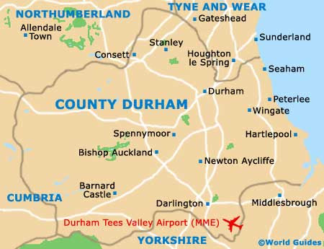



Supporting County Durham CCG commissioned health services in upholding their responsibilities identified in the SEND Code of Practice

Slide 3

SEND CCG: Laura Coulthard (Designated Clinical Officer for SEND).
(laura.coulthard1@nhs.net)
General Paediatric Services (location based)
General paediatricians
Community nurses
Children & Adolescent Mental Health Service (CAMHS)
TEWV NHS Trust
Specialist Paediatric Teams
Great North Children’s Hospital (Newcastle University Teaching Hospital NHS Trust)
North Teeside & Hartlepool Trust
Peterlee, Shotton, Wingate, Hutton, Henry, Wingate, Blackhall, Horden Heslesdon, Easington colliery Easington Village
County Durham and Darlington NHS Trust (CDDFT)
South Tyneside & Sunderland Trust
Seaham, Murton
& South Hetton
Child/Young Person
Speech and Language Therapy
North Tees and Hartlepool
Eye care and Orthodontics
(NHS/E)
CCG for County Durham commissioners:
Children & young people
Adult
Mental health and learning disabilities partnership
Occupational Therapy (CDDFT)
Children’s Continuing Care (CCG)
Looked After Children
CDDFT/Harrogate & District
GPs/Primary Care Networks (PCNs)
(CCG)
Physiotherapy (CDDFT)

Slide 4
March 2019
October 2021
Raise and resolve issues quickly
Build relationships: MCT co-produced parental letters for CAMHS autism diagnostic pathway.
Identifying opportunities
Escalating gaps in services
Developing the Personal health Budget offer
Strengthen connections between the health estate, commissioners, MCT, education and the Local authority
Building relationships
Mutual respect
Open and honest communication
Feedback:
Parent/carers and YP
Feedback opportunities for EHCP audits
Health advice being sent to parents/carers/YP.
SEND partnership is developing more opportunities for communication.
SEND champions in all teams.
Monthly SEND/EHCP training to health practitioners
Quality of health advice for EHC assessments has improved
  New health template
  Fortnightly deep-dive audits
  EHCP buddies
Strengthen knowledge and understanding of SEND across Durham's’ health practitioners’
Knowledge and training

Slide 5
Current issues
Increase in assessment waiting lists across health services
  Increase in referrals (mental health)
  Impact of COVID
  Staff retention
  Staff recruitment
Significant (nationwide) increase in placement breakdowns for C/YP and a lack of suitable placement options.
Notes:
COVID: Staff leaving, long-covid, redeployment of paediatric staff in the first lockdown.
Many vacant positions in all paediatric health teams which we are having difficulty recruiting to and services are looking at different models of recruitment –
Staff retention - such as newly qualified staff getting their first job after university, typically graduating from Newcastle, take a first job and then go back and work where they live and have friendships.
Crisis in mental health.

Slide 6
March 2019
October 2021
CCG Funding and investments
Funding bid for additional support for OT and physio waiting lists
Supporting the needs led neuro-developmental pathway
Funding a new SENDIAS role to support families
Looking to support additional carers services
Redeveloping how therapies are delivered into schools - a pilot starting in 2 special schools.
Supporting services to retain staff
Funding on-line mental health services

Slide 7

Word to describe autism
(July 2021)
Dr. Laura Coulthard (Designated Clinical officer, County Durham NHS CCG)
The survey

Slide 8

Why ask?
It started with a debate 11 years ago
“Autism” and/or “autistic”
“ASD” and Autistic Spectrum Disorder
Autism advocacy groups and research favoured the term autism and advised against using the terms Autistic Spectrum Disorder (ASD).
NICE (2010 NHS) Recognised many different terms and opted for autism.
Despite this, Autistic Spectrum Disorder (ASD) is still a commonly used term.

Slide 9
The survey
Word to describe autism (Laura Coulthard, March 2021, County Durham CCG)
Method
Short survey co-produced with young people form the Extreme group (County Durham)
What do you think about the following terms from 1 (do not like) to 5 (like very much)?
1. Autistic Spectrum Condition or ASC
2. Autistic
3. Autistic Spectrum Disorder (ASD)
4. On the autistic spectrum
Which term do you prefer most?
1. Autistic Spectrum Condition
2. Autistic
3. Autistic Spectrum Disorder
4. On the autistic spectrum
5. Other
Are there other terms you use to describe autism?
What was asked?
Who took part?
Autistic adults and autistic young people
Parents/carer of autistic children, young people and adults
Health and Education practitioners
Interested others
Participants
Autistic adults
Autistic young people
Parents /carers
County Durham connections
573
106
9
386
94

Slide 10
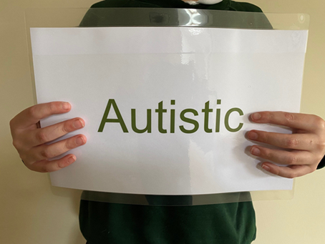



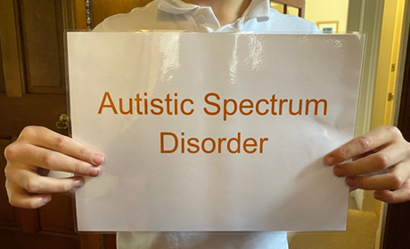




Results
Liked the most
Everyone
Autistic people
Disliked the most
Autistic people
Everyone
Preferred term overall
Everyone
Autistic people

Slide 11
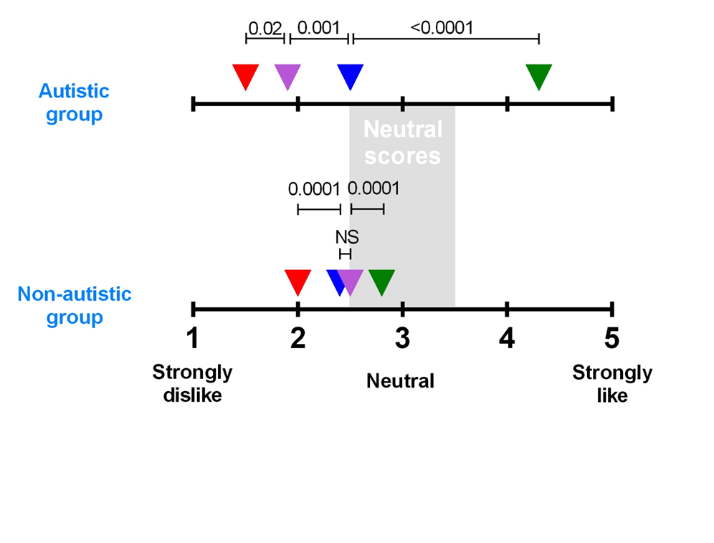
Figure 3: The mean scores allocated by the autistic and non-autistic respondent groups to the four diagnostic terms listed in the questionnaire, where 1 indicates a strong dislike, 3 is neutral, and 5 indicates a strong liking. Red=autistic spectrum Disorder, purple=on the autistic Spectrum, blue= autistic spectrum Condition, and green=Autistic. The statistical significance of the differences between the choice of diagnostic terms within each group are shown as p values above the plots.
Results

Slide 12
Feedback?
Positive comments from Parent Forums and local groups
"Thank you so much for sharing this survey with…the parent carer forum for Dorset. This topic is extremely important and is something being highlighted as something that needs to be understood through the NHS Long Term plan". (PCF)
Parent Carer Forums
"I want to thank you for actually asking autistic people what their preferred language is” (PCF)
"Your results are really interesting and backs up the research and terminology we’ve been using for a number of years now". (NEAS)
Well done for pulling together such clear feedback on language…I also want to offer my, and our Trust of schools, support for ongoing work and research. I…want to improve provision for autistic people across the region…I'm so excited to see the agreed movement in language that I've pushed for!..." (County Durham School)
Local groups
“I think people should have more empathy…I think it should be compulsory to listen to this feedback (Young person 1)”
Extreme group
Feedback session (5 YP aged 12-20)
“Autism isn’t an alternative word, it is the right word” (young person 2)

Slide 13
Government National Strategy for autistic children, young people and adults: 2021-2026
No reference to ‘ASD’
1 reference to Autistic Spectrum Disorder - context - a journal title.
“Need to improve data collection about autism…to have a deeper understanding of people’s experienced across health and care services”.
CDDFT Paediatrics
CAMHS autism diagnosis service
Centre for Neurodevelopmental Disorders is now “Centre for Neurodiversity & Development”
Local change

Slide 14



Inclusive and accessible dissemination of survey results
Next steps?
Voice of the autistic community for feedback and to enable a strategic system-wide response (including autistic young people)
To obtain a position statement from stakeholders, leaders and NHS providers around the issues raised

