Slide 1
County Durham and Darlington Needs Led Neurodevelopmental Pathway
Jill Raeburn, Service Manager
Rachael Allen, Team Manager
County Durham & Darlington CAMHS

Slide 2
What do we mean by Neurodevelopmental?
Lifelong
Difficulties including: Cognition, language, motor development, attention, emotional regulation, social communication
Evidence that neurodevelopmental conditions co-occur
Two of the most common Neurodevelopmental conditions are ADHD and Autism

Slide 3
Why “Needs led?”
Parents highlighted the importance of needs being met, regardless of diagnosis
Confusion over what services were available without diagnosis
Importance of a culture change across the system away from diagnosis

Slide 4
Needs Led Offer/Bubble of Support
Information brought together for the local area
Additional funding available to minimise ‘gaps’ identified eg Contact service in Darlington
Emphasis on support and advice being available regardless of diagnosis

Slide 5
Neurodevelopmental Assessment Team
TEWV service
Brings together previous Autism and ADHD assessment pathways
CCG investment to increase capacity to meet increased demand/reduce waiting lists

Slide 6
Referral Process
The form has three sections: for professional who knows the child/young person well, family/carers and young person
Professional submits the completed form which is reviewed by multi-agency panel
Based on information available, feedback to referrer and family on whether neurodevelopmental assessment indicated
Local support offer available before, during and after assessment

Slide 7
County Durham Pathway

Slide 8
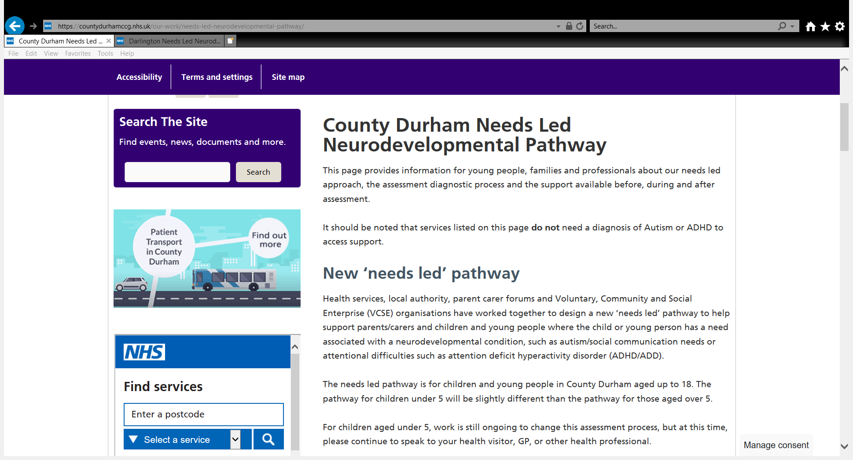
https://countydurhamccg.nhs.uk/our-work/needs-led-neurodevelopmental-pathway/
CCG hosted websites
https://teesvalleyccg.nhs.uk/our-work/darlington-needs-led-neurodevelopmental-pathway/

Slide 9
Changes that Families/Carers will see
Go Live dates: Darlington April 2021 Co Durham October 2021
Availability of local website
Improved access to advice and information on what support is available, regardless of diagnosis
Introduction of Referral Form
Early feedback on whether this will progress to further clinical assessment – replacing previous time within a CAMHS mental health team
Single assessment process for Autism and ADHD
Improved communication – TEWV are working with service user and carer groups to improve this, and are contacting families regularly with suggestions of support that is available

Slide 10
Further information / queries?
jill.raeburn@nhs.net
rachael.allen13@nhs.net

