Slide 1
Special Educational Needs and Disabilities (SEND) Update
Making Changes Together
November 2022

Slide 2
What I Will Cover
SEND Strategy Update
Education Health Care Plan
Primary SEND Trends
SEND Green Paper Update

Slide 3

Action Area Headings
Attendance
Family Resilience
Voice of Children and young People
Meeting Needs
Workforce
Promoting the ‘Local’ Offer

Slide 4
The number of children and young people with an EHCP or receiving SEN Support continues to increase year-on-year
There has been a 37% increase in EHCPs in the last 4 years. That is 1,082 more young people with an EHCP
There has been a 25% increase in the number of young people with a SEND Support Plan. That is 2,128 more young people
17.6% of Durham pupils have an identified SEND compared to 16.6% in England.
SEN Support and Education Health and Care Plans

Slide 5
EHCP Requests
Requests for EHCP assessments are higher than pre-COVID.
Between 2019 to 2021 Durham’s requests rose by 17%. This is higher than the national and regional with increases of 13% and 6% respectively.
2022 year-to-date figures are on track to outpace previous years. 687 requests Apr-Sep22 compared to 464 in Apr-Sep21
Around 1 in 5 requests are for under 5s with a third for secondary age pupils – This has increased and is higher than in our comparators

Slide 6
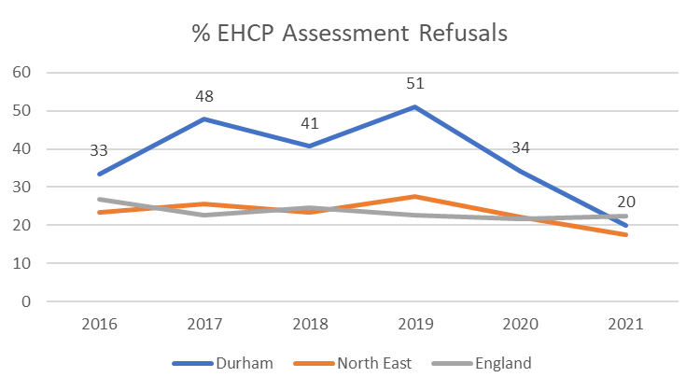
EHCP Assessment Refusals
Prior to 2019 Durham was an outlier for EHCP assessment refusals with around 45% requests refused when first received. Many of these decisions were later overturned and young people went onto receive an EHCP
Following changes to the decision making process in 2019 refusals for EHCP assessments have fallen and in 2021 were 20% bringing us in line with national and regional averages
2022 YTD figures show a further decrease in refusals to 11% of all EHCP requests

Slide 7
Primary Need and Placement of our children and young people with an EHCP

Slide 8
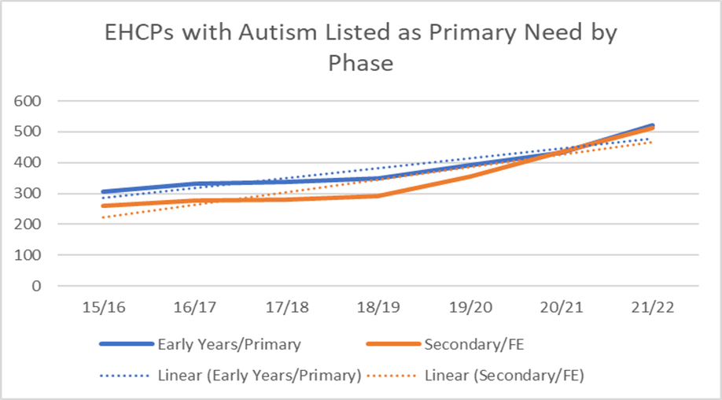
Autism Analysis
The number and rate per 1,000 pupils with Autism is increasing
Whilst this has risen across the country, the rate in Durham is now statistically significantly higher than the national average
The increase is evident in both early years/primary and secondary/FE phases

Slide 9
National Policy Developments in SEND

Slide 10
SEND Green Paper
The Department for Education (DfE) have been seeking views on their published Green Paper
'Right Support, Right Time'. The paper sets out the changes the DfE want to make to the SEND and alternative provision system in England. The consultation ran from 29 March to 22 July 2022
A response to the Green Paper was put together through engagement with Service Users and Key Stakeholders including members of Overview and Scrutiny Committee and submitted to the consultation
Durham's response along with all others submitted is being analysed by the DfE and an update is expected later in the year.

