Slide 1
Enabling inclusive communities for children and young people with SEND in County Durham to allow short breaks from caring when needed
Working in partnership

Slide 2
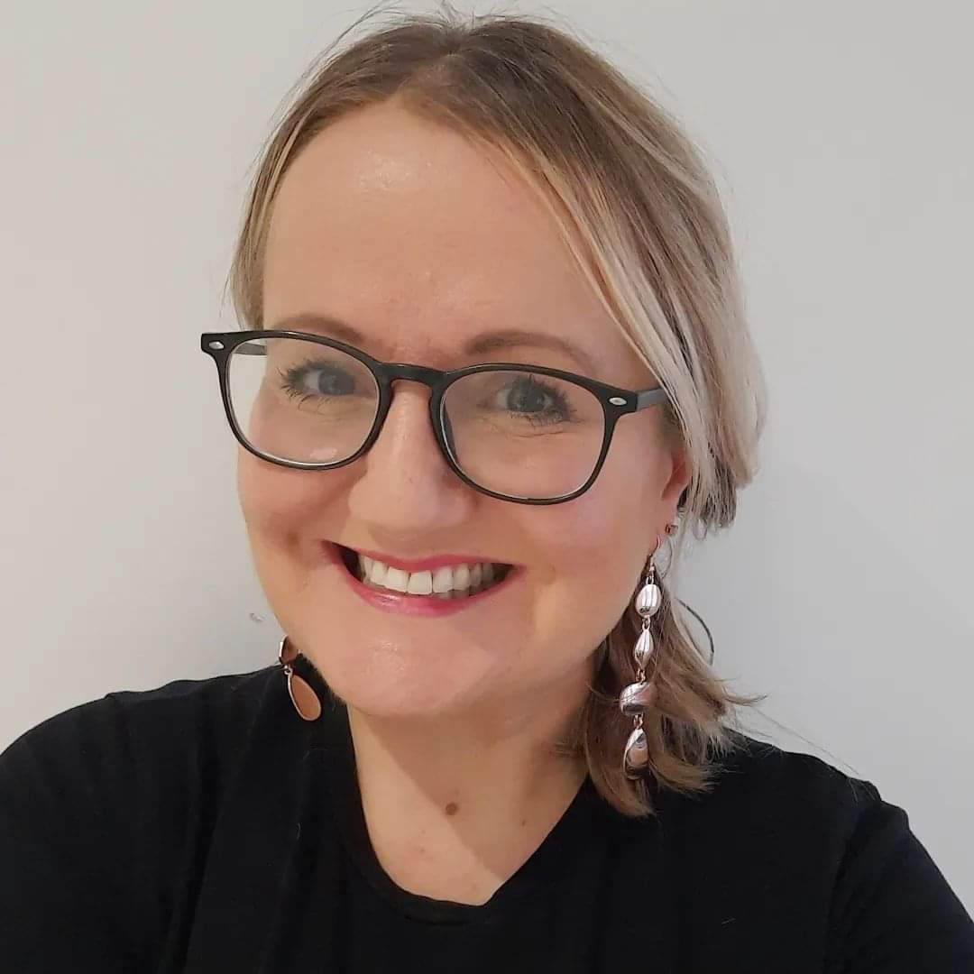

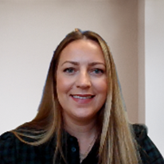
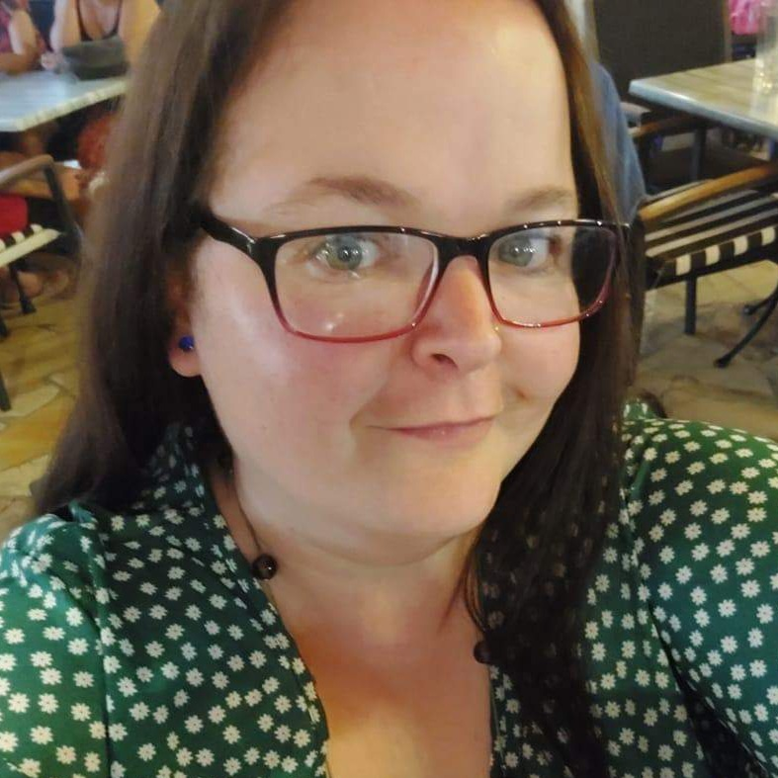
Lyndsey Dunn, Project Lead
Ruth Pope, Enabling Inclusive Communities Co-Ordinator
Danielle Pope, Short Breaks Solutions Officer
Sara Rawle – Parent / carer lead

Slide 3


We want:
Parent/ carers of children/young people with SEN/D to be able to have a short break from caring when needed.

Slide 4





We want:
Opportunities that enable children and young people with disabilities to access their local community.
This Photo by Unknown Author is licensed under CC BY-NC-ND

Slide 5

*Help families access existing community activities.
*Remove any barriers and fill gaps.
*For those unable to access the community, ensure the right support is available to enable access to activities without a social care assessment.
*Develop sufficient specialist and enhanced services to enable access for children who are complex and challenging to meet their needs identified as part of a social care assessment.
Enabling Inclusive Communities
to allow short breaks from caring

Slide 6


Current short break offer
Short Breaks Solutions Officer – first point of contact for families to explore existing community activities.
03000 260 270. shortbreakssolutions@durham.gov.uk
Enabling Inclusive Communities Co-Ordinator – to work with families and providers to remove barriers to enable access.
SEND Supported Community Activities – a range of services for those families unable to access the existing offer in response to needs/ gaps.
Specialist services – to meet the needs of families identified as part of a social care statutory assessment

Slide 7



SEND Supported Community Activities
For families unable to access the existing community activities
Family trips outs
Supported families youth groups
Preparation and transition sessions
Virtual gaming session
Additional support social sessions e.g Gym, swimming, cinema
Supported physical activity sessions
Specialist small youth groups
Weekly family groups e.g Taekwondo, trampolining
This Photo by Unknown Author is licensed under CC BY-SA-NC
This Photo by Unknown Author is licensed under CC BY-SA

Slide 8

Priority – Build on existing community activities
Understand needs
Continue to work with families to understand your needs including more families who are hard to reach.
Map existing provision
Research what community activities exist across County Durham.
Communicate
Strengthen our communication with families.
What is working well
Determine what is working well for families and community provision.
What are the barriers
Understand barriers to access and gaps and remove.

Slide 9
Reduce families unable to access
Ongoing review
The right specialist support
Reduce the number of families unable to access. But, for those who cannot, co-produce solutions and commission an offer to meet their needs without having an assessment.
Continue to review what we are doing together.
For those families who require specialist support we will work with families and social work teams to understand quality and commission support in line with statutory assessments.

Slide 10


Let's do this together!!
What is out there and where?
What is working well and why?
What are the barriers and how can we overcome these?
What is the best way to communicate?
Would you like to be more involved in this work…?

Slide 11



If you feel you know a family are in need of a short break from their caring role but unsure how to get one – please contact Short Breaks Solutions by phoning the telephone or email address below.
Telephone: 03000 260 270
Email: shortbreakssolutions@durham.gov.uk
We can work together to co-ordinate a creative response for families.

