Slide 1

We are Integrating

Slide 2
Who are we?
small local charity based in County Durham (Durham and Chester-le-Street)
offer social activities to children and young people with a range of disabilities and learning difficulties aged between 5-30 yrs
Day Service for people aged 16yrs+ not in full-time education
work with around 90 service users annually
deliver on average 15,000 activity hours term time and in school holidays

Slide 3
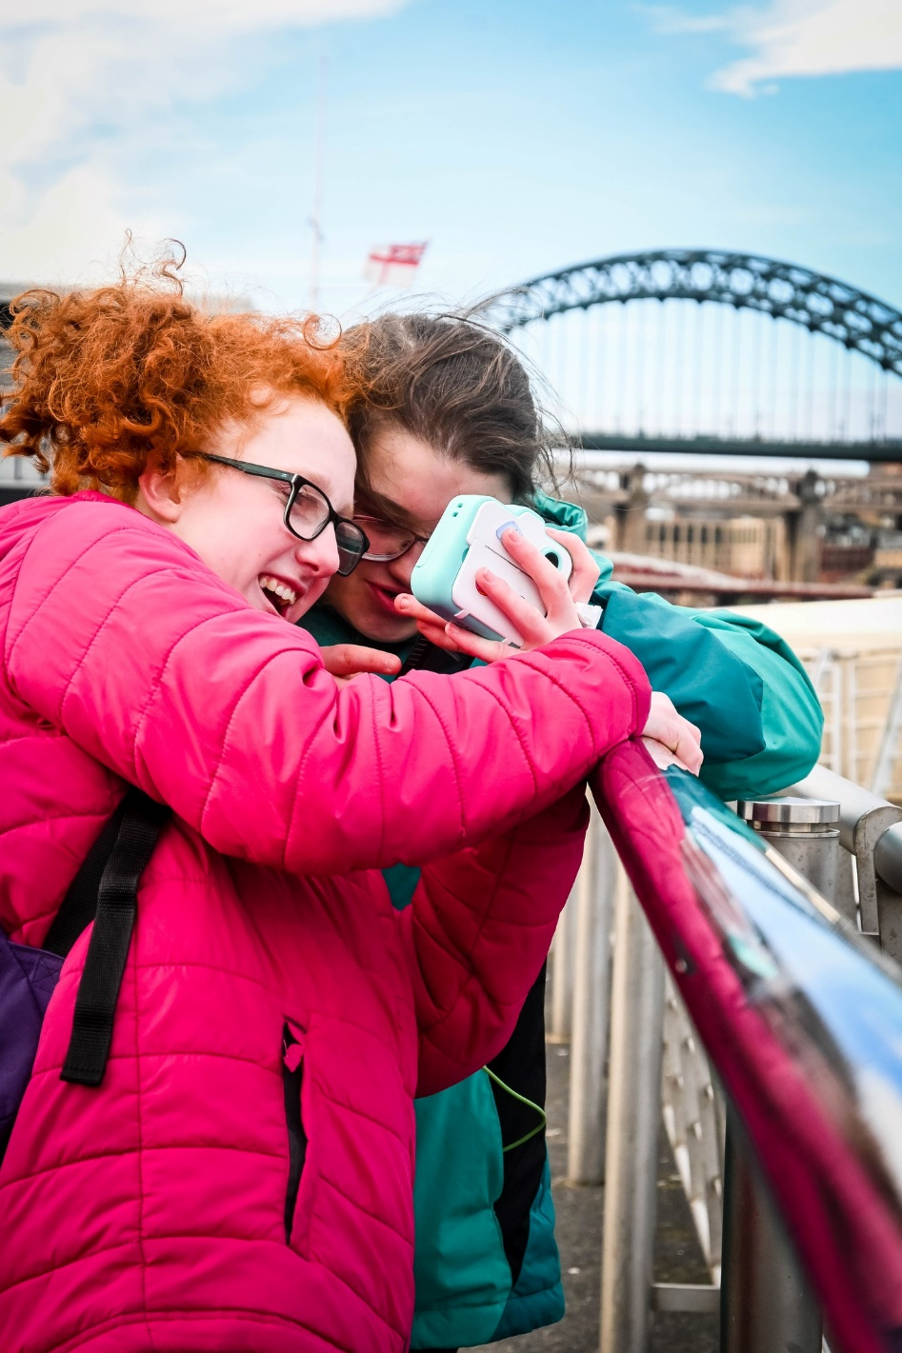
Our Users
Integrating has boosted my independence skills and has helped me a lot to focus. I am less distracted than normally - Sophie

Slide 4
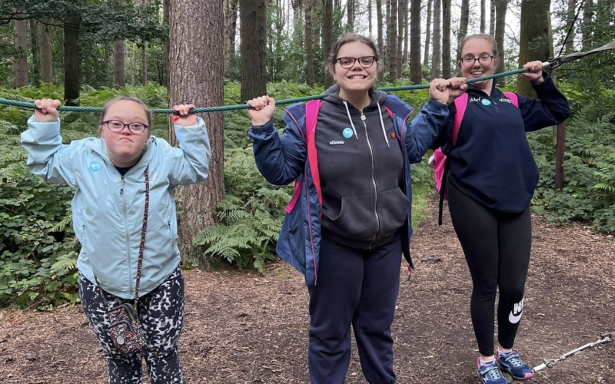
Our Users
You’re always going to have someone who talk to you. I can’t stress how much they’ve helped me and been an influence on me. I just love you Integrating - Emma

Slide 5
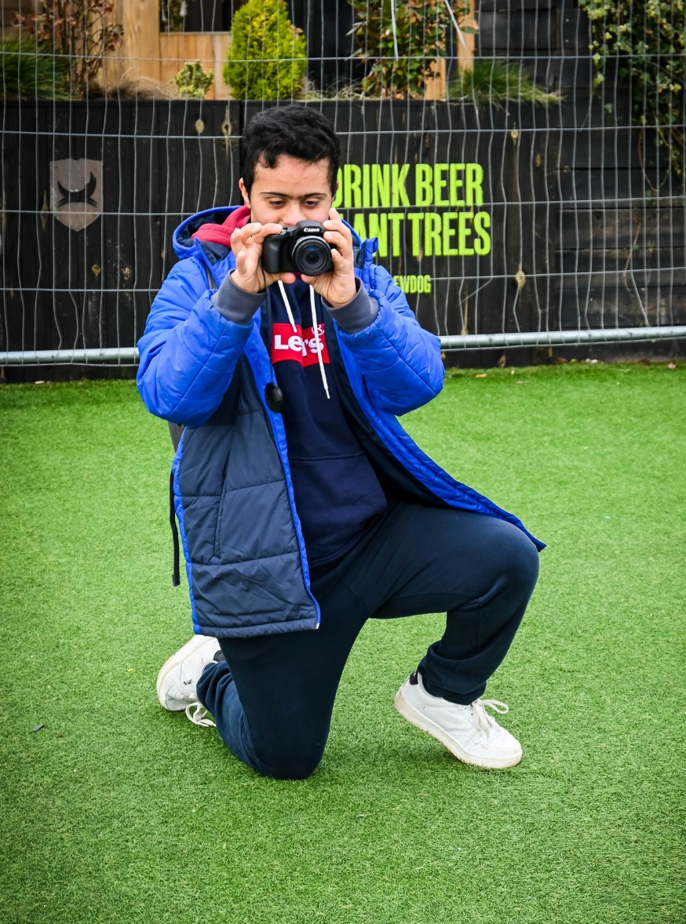
Our Parents
I think it’s a really brilliant organisation. For me its about helping my son have more of a normal social life than he might otherwise have. He can join ordinary activities with people in the community without his mam. It gives me a break, and gives him a break from me - Parent

Slide 6
Our Activities
During the week we host a range of activities 5pm-7pm
Monday - Visual Arts and Gym Group
Tuesday - Music Group
Wednesday - Sportability and Football
Thursday - Bowling
Friday - Quizzes, Bingo and Discos

Slide 7
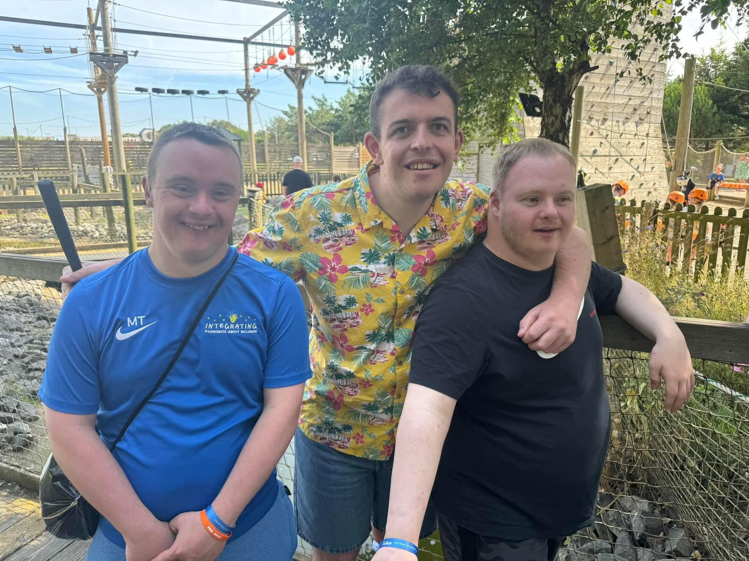
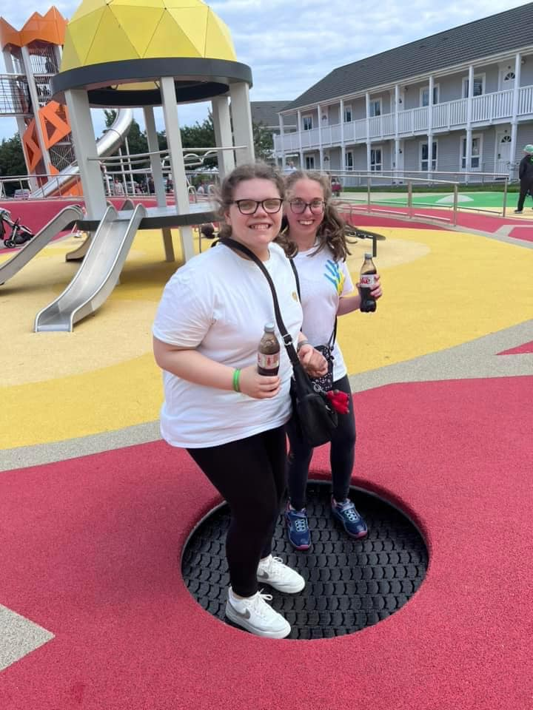
Our Activities

Slide 8
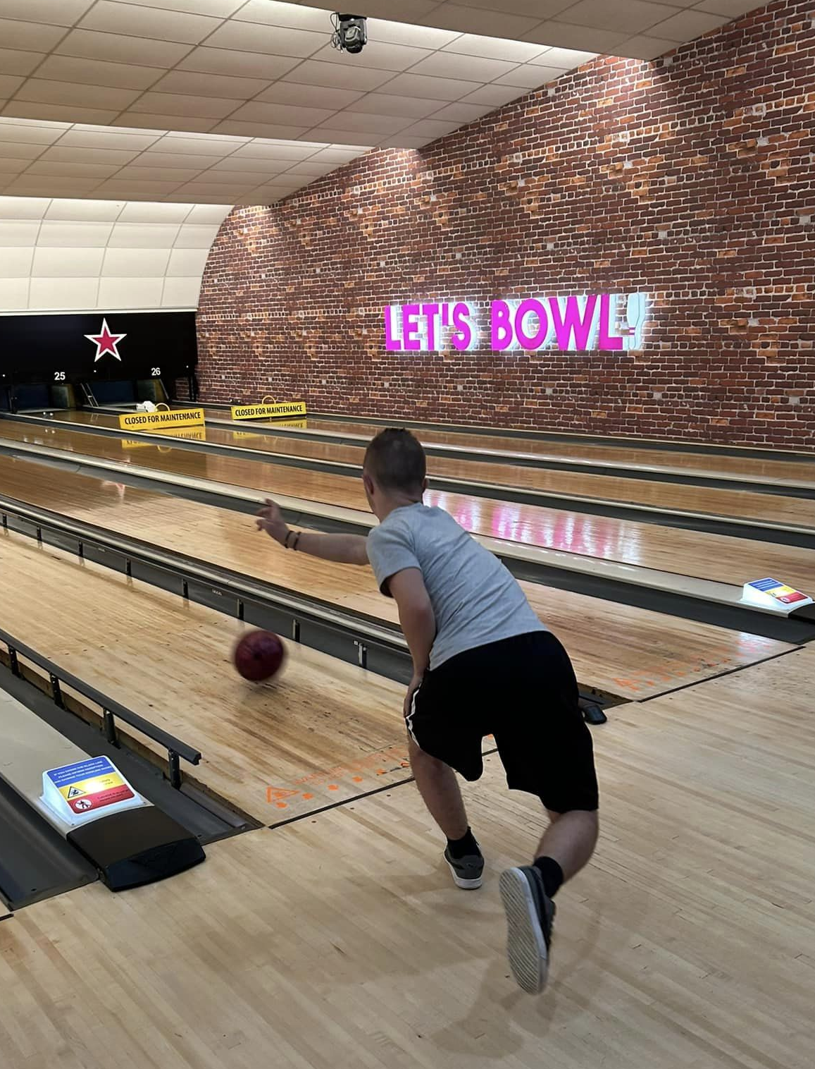
Our Activities
On a Saturday and in the holidays, we run a range of exciting activities.
We often like to go to the cinema and swimming baths then go for pub lunch.
In the school holidays, we like to visit zoos, theme parks and museums.

Slide 9
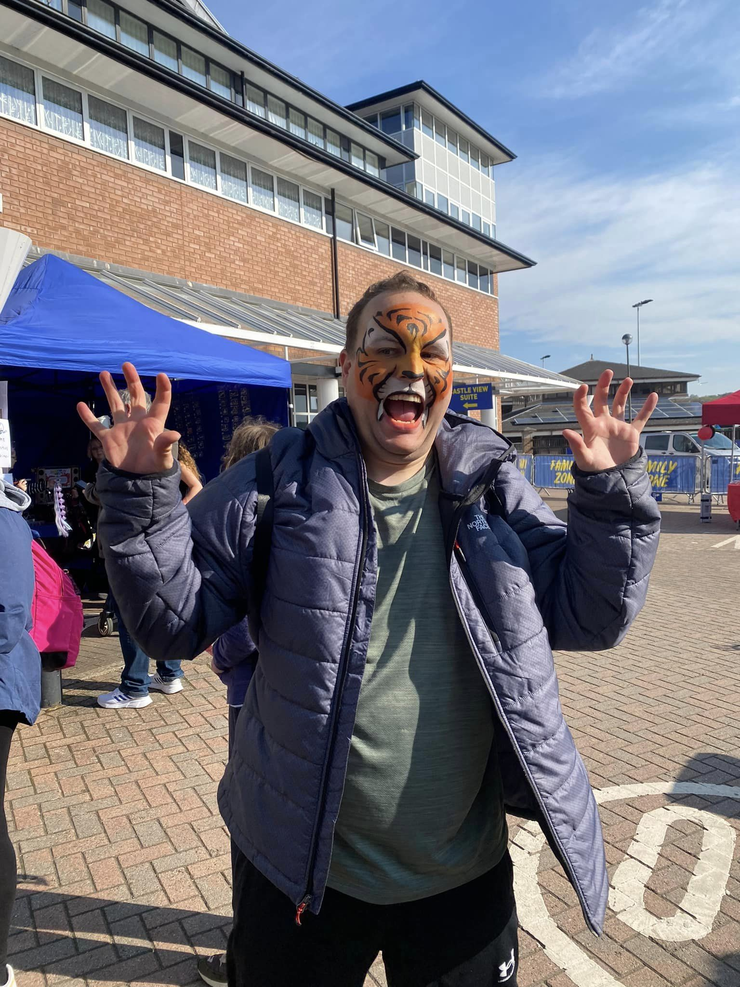
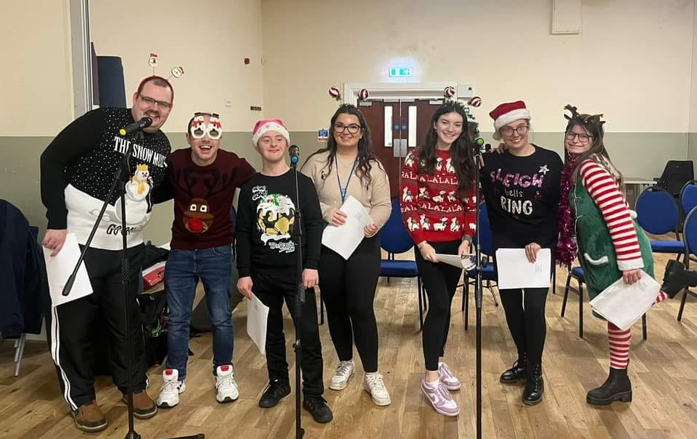
Our Activities

Slide 10
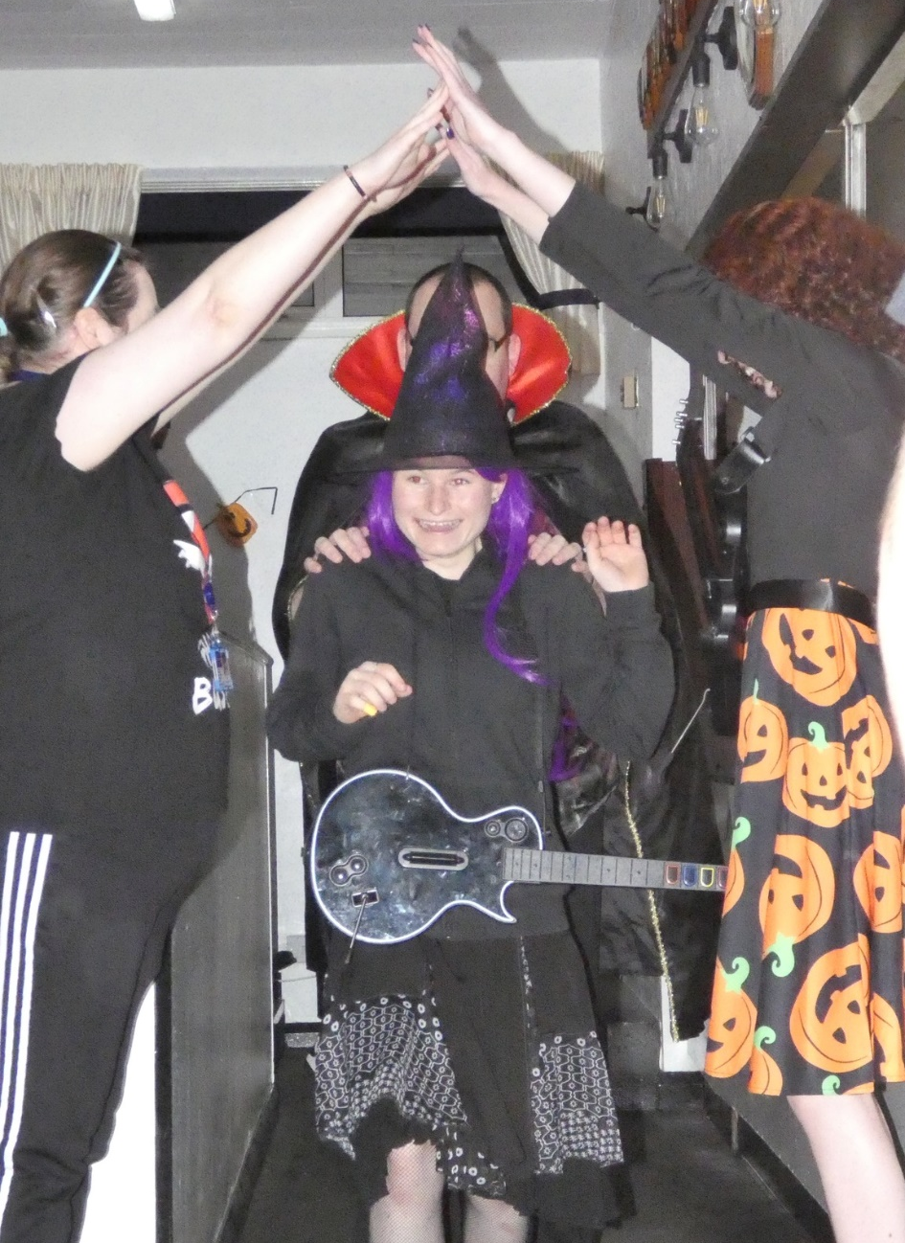
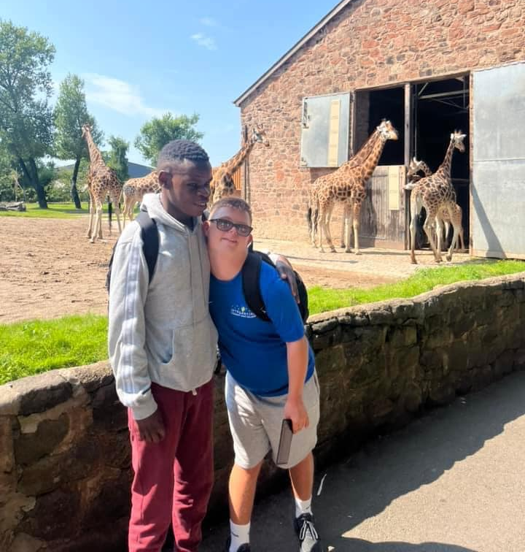
Our Activities

Slide 11
Our Activities
This year, 24 young people enjoyed a trip to Butlins, spending five days packed with activities like swimming, a silent disco, and fairground rides.
“It was the best week ever! I got to spend it with my best friends and make new friends when I was there!”

Slide 12
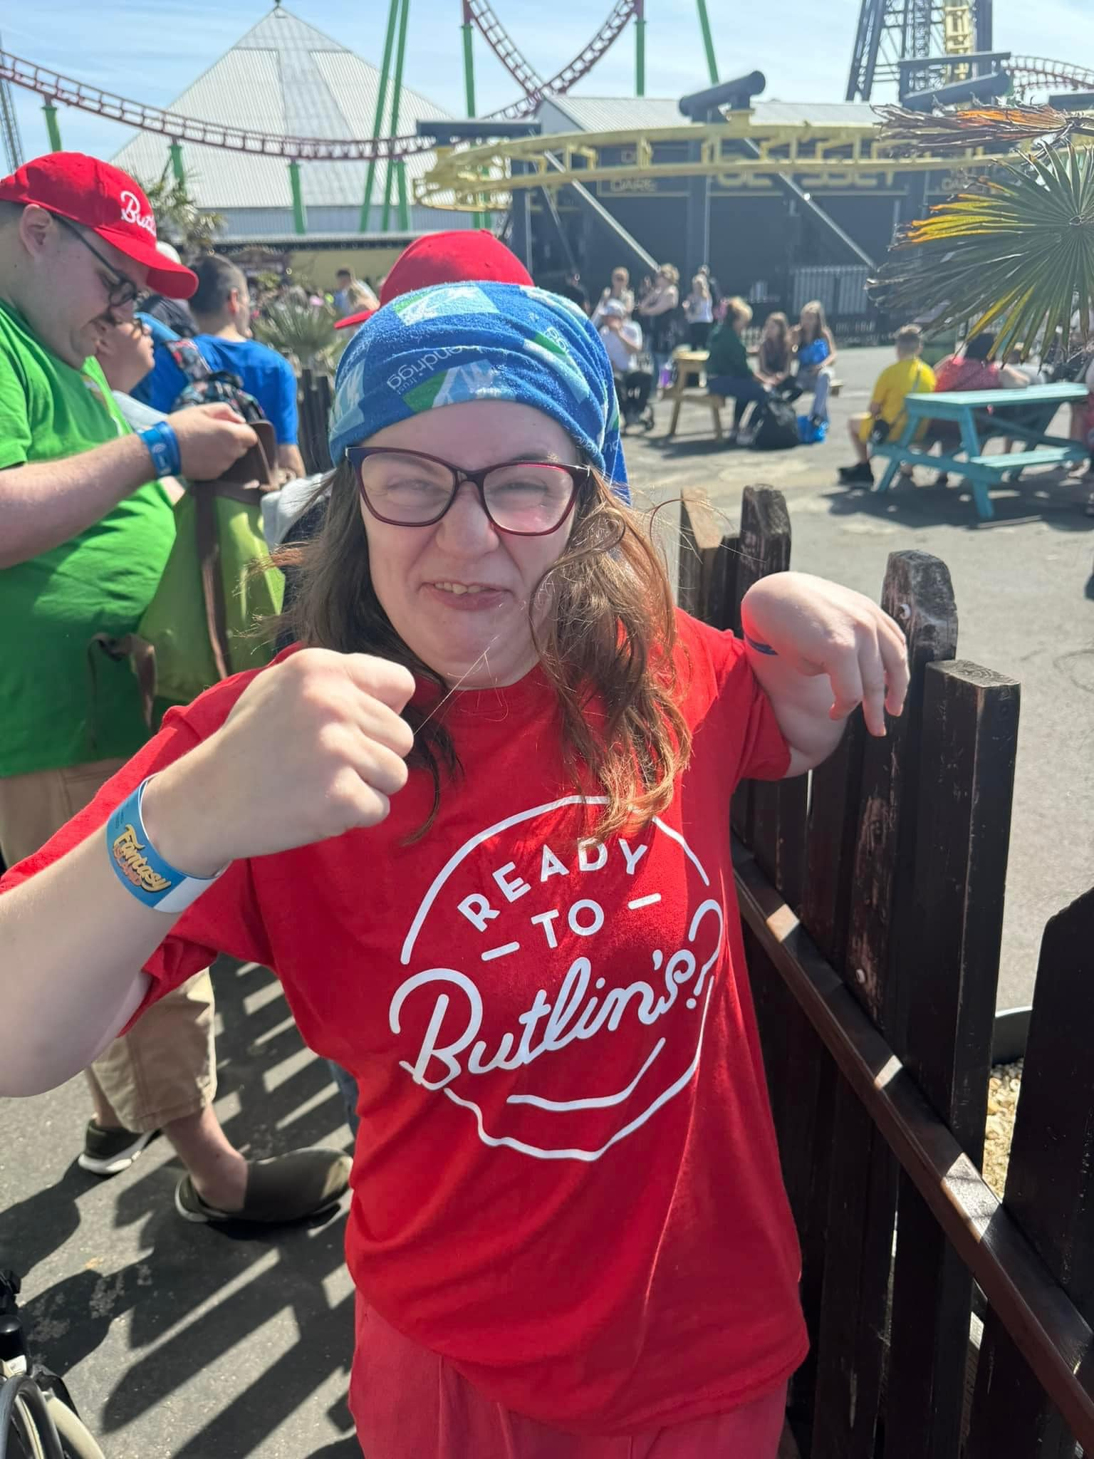
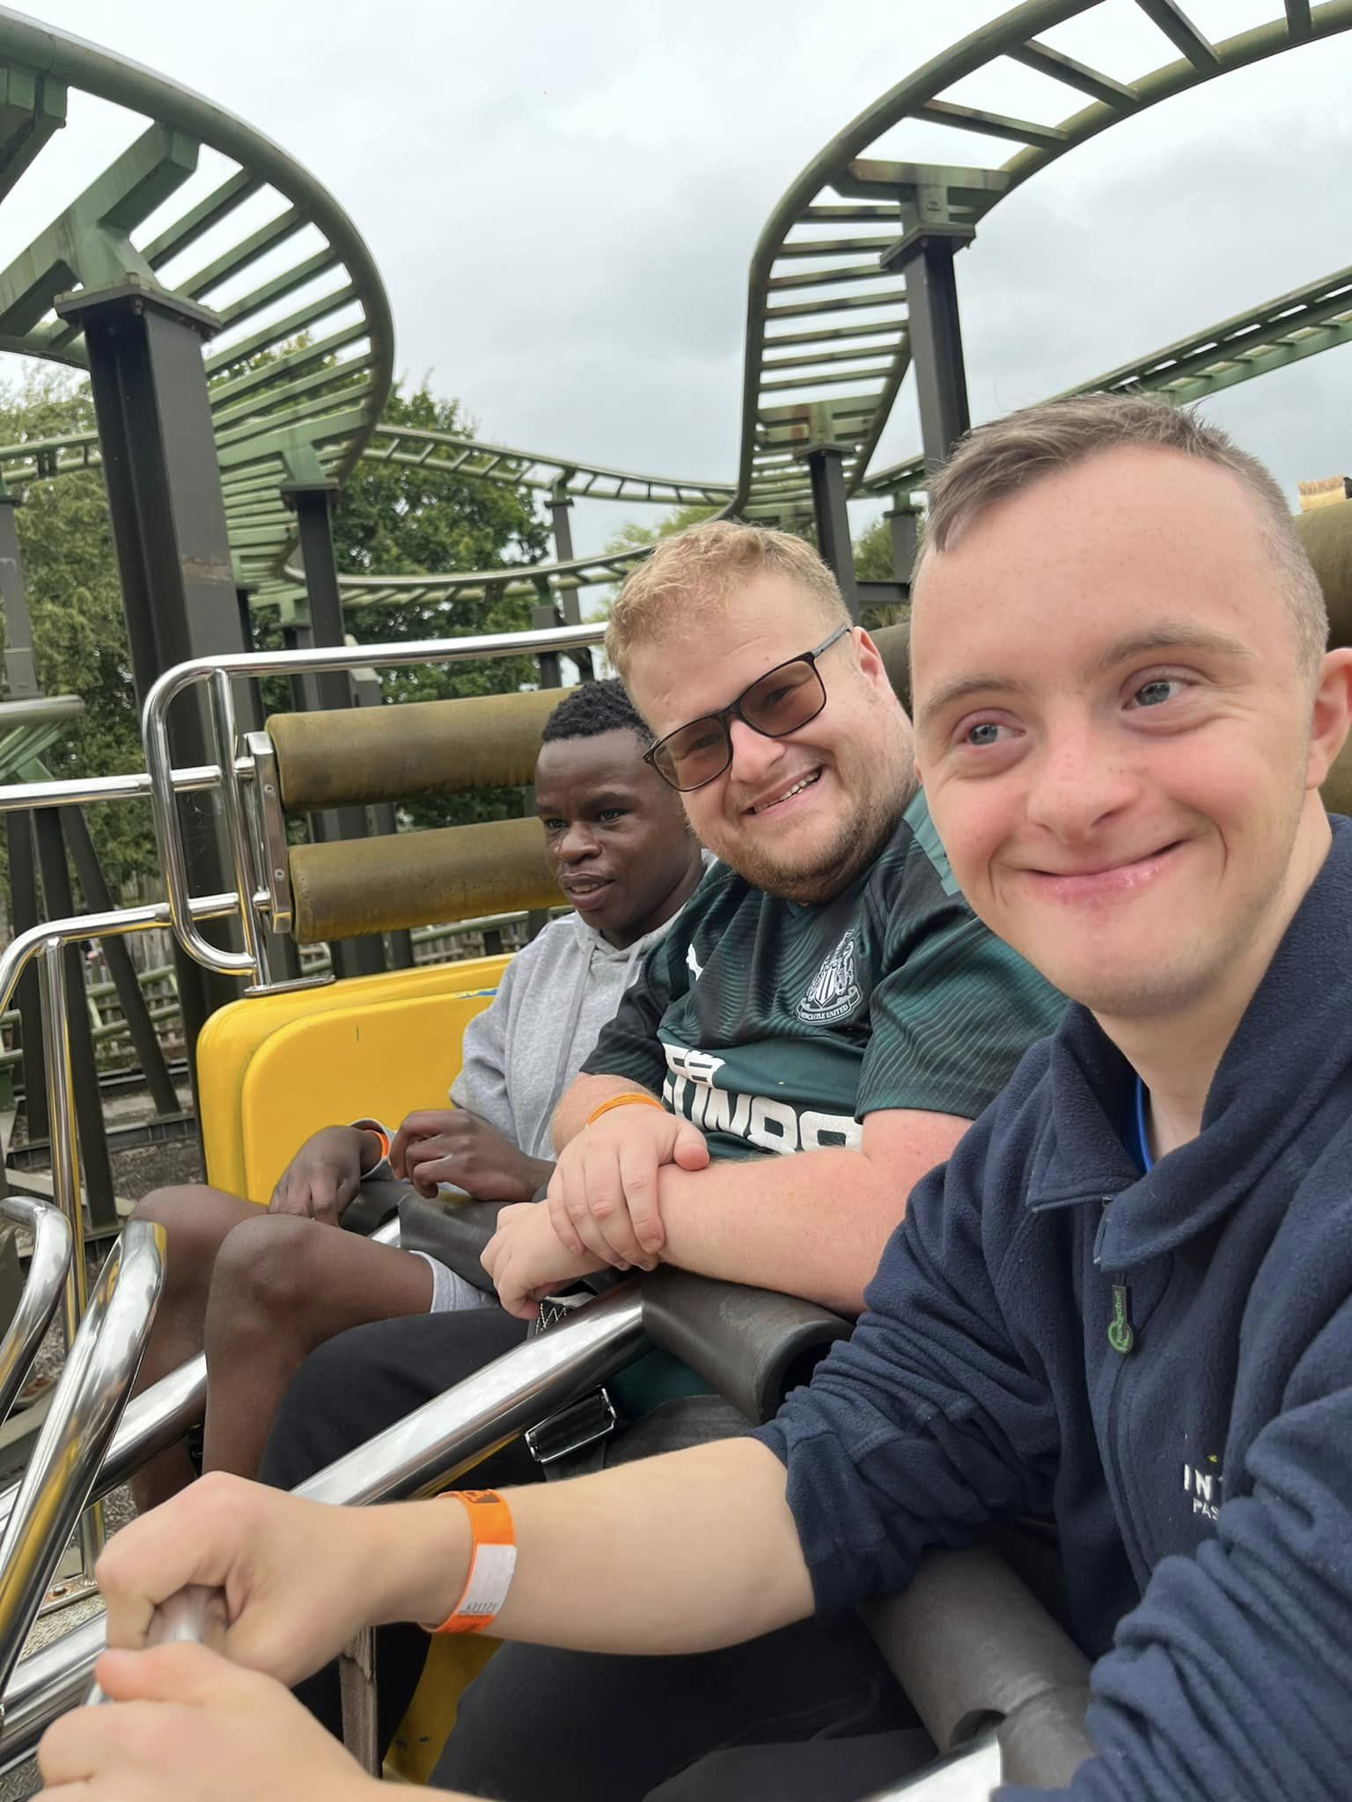
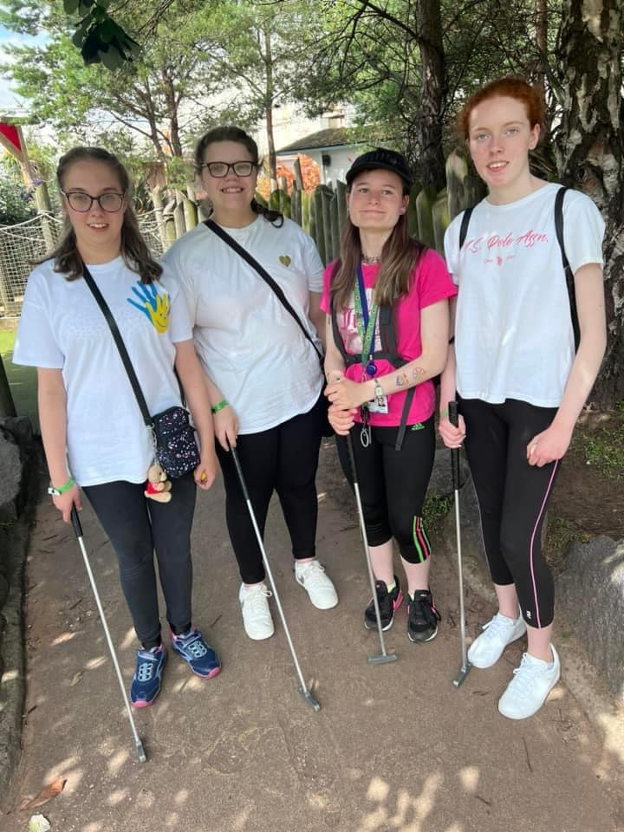
Our Activities

Slide 13
Get in touch
Office: 07914 376228
Email: info@integrating.org.uk
Bullion Hall
South Approach
Chester-le-Street
County Durham
DH2 2DW

