Slide 1
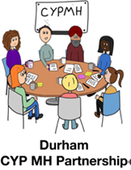
Child and Adolescent Mental Health Service
(CAMHS) .
I-Thrive Model.
Claire Houghton,
East Getting Help Services Team Manager.
I Thrive Model in CAMHS and our partner agencies.

Slide 2
What is the Thrive Framework?
The THRIVE Framework provides a set of principles for creating coherent and resource-efficient communities of mental health and wellbeing support for children, young people and families.
It aims to talk about mental health and mental health support in a common language that everyone understands. The Framework is needs-led.
This means that mental health needs are defined by children, young people and families alongside professionals through shared decision making. Needs are not based on severity, diagnosis or health care pathways

Slide 3
The THRIVE framework is for:
• All children and young people aged 0–25 within a specified locality
• All families and carers of children and young people aged 0–25 within a specified locality
• Any professionals who seek to promote mental health awareness and help children and young people with mental health and wellbeing needs or those at risk of mental health difficulties (whether staff in educational settings, social care, voluntary or health sectors or others

Slide 4
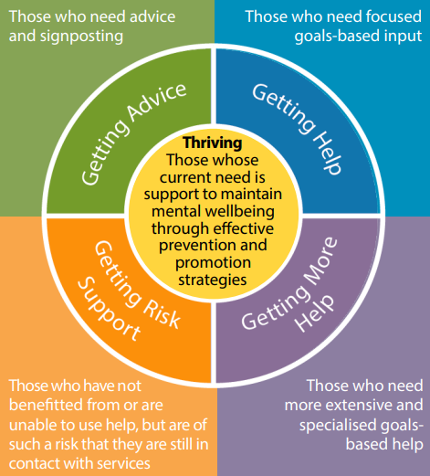
THRIVE-Framework-for-system-change-2019.pdf (implementingthrive.org)

Slide 5
Thriving - Those whose current need is support in maintaining mental wellbeing, emotional wellbeing and social wellbeing through effective prevention and resilience-based strategies
This group includes children and young people who are doing well mentally, emotionally and socially and don't need individualised advice or support for their ups and downs in life. About 82% of children in County Durham fall into this category at any given time. While they may not need specific advice or support, they can still benefit from general prevention and promotion efforts. Communities such as schools following the i-THRIVE Framework should think about how to support these initiatives at a larger level.
Within this group, there are children and young people who face extra challenges due to social factors like poverty or environmental factors like discrimination. The system should take special care to address these issues systematically and ensure that these groups have access to prevention and resilience-based strategies tailored to their needs.
Thriving

Slide 6
Getting Advice
Getting Advice - Those who need advice and signposting
This category includes children and young people who need advice and direction. In County Durham around 5% of children and young people will need advice and guidance. It covers those facing mild or temporary difficulties and those dealing with ongoing severe problems but managing their mental wellbeing, emotional wellbeing and social wellbeing independently.
Information shared should aim to empower young people and families in finding the best ways to support their own mental wellbeing, emotional wellbeing and social wellbeing.
This group might include vulnerable individuals due to social factors like poverty or individual factors such as abuse. The system needs to address these challenges systematically and make sure these groups have access to prevention and resilience-based strategies meeting their needs.
Getting More ep

Slide 7
Getting dice
Getting Help - Those who need focused goals-based input
This group includes children and young people who need specific help for mental wellbeing, emotional wellbeing or social wellbeing focusing on agreed-upon outcomes. It involves professionals taking direct responsibility to assist individuals or groups. About 11% of children and young people in County Durham will need services in the Getting Help part of the offer.
These professionals may not be mental health experts but can offer targeted help for specific issues relating to mental wellbeing, emotional wellbeing, socially wellbeing and resilience building. Interventions have clear goals from the start, outlining what success looks like, the likelihood of achieving it by a certain date, and what happens if the goals aren't met. If an intervention isn't working or the benefits no longer outweigh the costs, it's stopped.
This grouping comprises those children, young people and families who would benefit from focused, evidence-based help and support, with clear aims, and criteria for assessing whether these aims have been achieved.
Getting Help
Getting Risk Support
Getting More Help

Slide 8
Getting Advice
Getting More Help - Those who need more extensive and specialised goals-based help
Getting More Help is similar, to Getting Help but covers approximately only 1% of children and young people. It is a separate needs-based intensive support offer with individuals requiring more support with a collaborative approach if more than one service is involved in their care.
Children and young people requiring Getting More Help include
• the child or young person is completely unable to participate age appropriately in daily activities in at least one context (e.g. school, home, with peers)
• they may even be unable to function in all domains (e.g. staying at home or in bed all day without taking part in social activities)
• they need constant supervision (due to their level of difficulties they are no longer managing self-care) and experience distress on a daily basis.
This grouping can include those children and young people that were unable to achieve the goals as part of the Getting Help support. It might also include children with a range of overlapping needs that mean they may require greater input, such as the coexistence of autistic spectrum disorder (ASD), major trauma or broken attachments.
Getting More Help
Getting Help
Getting Risk Support

Slide 9
Getting Advice
Getting Risk Support - Those who have not benefitted from or are unable to use help, but are of such a risk that they are still in contact with services
The aim of Getting Risk Support is for all partners to be clear that what is being provided is managing risk ONLY.
It is important to note that children and young people may be in any category of the i-Thrive framework prior to needing risk management. However, in many cases they will be receiving advice, Getting Help or Getting More Help, but despite extensive input, there are concerns that they are making little progress and remain a risk to themselves or others. Children, young people and families account for 1% of children and young people in County Durham and will often have multi-agency support such as social services, Full Circle and youth justice.
This group includes children, young people, and families who can't benefit from evidence-based treatment right now but still pose a significant concern and risk. It might involve those who regularly experience crises but can't use the offered help, or situations where the assistance provided hasn't made a positive difference. This category may also cover individuals who engage in self-harm or have emerging personality disorders or ongoing issues that haven't responded to interventions.
Getting Risk Support
Getting Help
Getting More Help

Slide 10
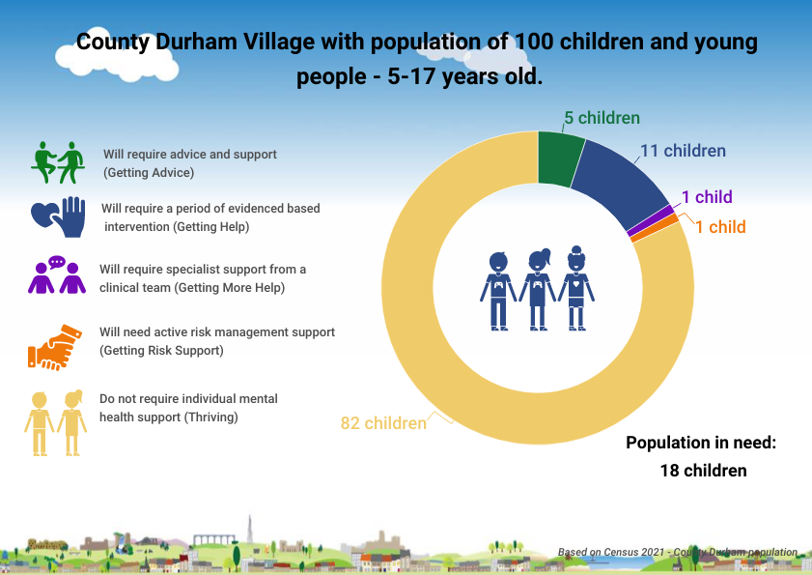
Estimate of Prevalence
(based on i-Thrive model and TEWV estimate)

Slide 11

https://youtu.be/ARAaiEoVpjQ

Slide 12
Piece of Mind (Mental Health Support Teams)
Family Hubs
Emotional Health and Resilience Team (HDFT)
DurhamWorks
Bereavement Support
Humankind – LGBTQ+ and Alcohol and Drugs Service
Child and Adolescent Mental Health Service (CAMHS) Single Point of Access
School Counselling Service
Kooth
Social Media and Apps
Online resources/websites
Helplines
Family Health Service (HDFT)
Family Hubs
Durham County Council teams including Emotional Wellbeing and Effective Learning Team/ SEND and Inclusion Team
Humankind – LGBTQ+
Youth Mental Health First Aid Training
GP Surgeries and PCN Clincians
Getting Advice
EXAMPLES OF SERVICES IN EACH CATEGORY (NOT EXHAUSTIVE)
Thriving
Voluntary and Community Groups
AAP Funded Projects
Youth Groups and After School Clubs
Social Media
Five Ways to Wellbeing Campaigns
Nurturing Our Wellbeing – Primary Schools
Youth Aware Mental Health – Secondary Schools
Health and Wellbeing Framework
RSHE Curriculum
Peer Mentors
Family Hubs
Family Health Service (HDFT)
Education Staff including Senior Mental Health Leads and Youth Mental Health First Aider
Durham County Council teams including Emotional Wellbeing and Effective Learning Team/ SEND and Inclusion Team
Getting Help
Emotional Health and Resilience Team (HDFT))
Child & Adolescent Mental Health Service – Getting Help Teams (CAMHS)
Full Circle
One Point Intensive Family Support
Durham County Council teams including Emotional Wellbeing and Effective Learning Team/ SEND and Inclusion Team
Rapid Response Teams CYP
NHS 111 CYP/F
CAMHS Crisis Team
Child & Adolescent Mental Health Service – Getting Help Teams (CAMHS)
Children’s Social Care First Contact
TEWV Adult Services
Rapid Response Teams
Emergency Services – 999
Getting Risk Support
Getting More Help

Slide 13
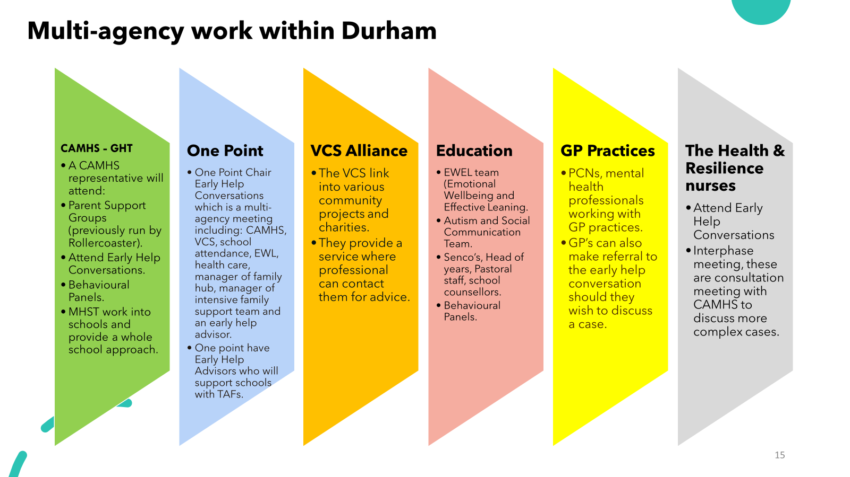

Slide 14
Link to all One Point Courses:
Help for families - your virtual Family Hub - Durham County Council

Slide 15

DURHAM EDUCATION OFFER
  Emotional Wellbeing Forums
  Health and Wellbeing Framework
  Anxious about School
  Durham Resilience Programme
  Youth Mental Health Aware/ Nurturing Our Wellbeing
  Senior Mental Health Leads Training
  Emotional Health & Resilience Team
  Piece of Mind Team (40% of schools can access)
Durham Education Offer Document
Notes:
Wanted to simplify for schools and would recommend link to Durham Education Offer as we aren’t expecting you to know about everything that is going on in your local community.

Slide 16


RAINBOW GUIDES
Mental health & emotional support for children, young people & families in County Durham
Notes:
Regular updates (every 6 months) and Xmas Rainbow Guide

