Slide 1
MCT Conference
Clare Nicholls & Peter Mulholland
06/05/2026

Slide 2

Notes:
Co‑production Approach: SEND Local Reform Plan
As part of the development of our SEND Local Reform Plan, we will deliver a dedicated Co‑production Fortnight designed to ensure the plan is shaped directly by the lived experience, insight and expertise of children and young people with SEND, their parents and carers, and the professionals and partners who support them.
The Co‑production Fortnight will combine large‑scale engagement with targeted, facilitated dialogue, enabling both breadth and depth of contribution across the local SEND system.
At the centre of this approach will be a borough‑wide co‑production survey hosted on the Let’s Talk County Durham platform. This will provide an accessible opportunity for parents, carers, young people and practitioners to share views on the key components of the SEND Local Reform Plan, including early intervention, inclusion, assessment and planning, provision, transitions and outcomes. The survey will be promoted widely across education, health, care, voluntary sector and community networks to maximise reach and inclusivity.
Alongside this, we will work with providers and partners across the SEND system—including early years settings, schools (mainstream and special), post‑16 providers, alternative provision, health services, commissioned services, voluntary and community organisations, and local authority teams—to facilitate structured group discussions and workshops, both in person and via Microsoft Teams. These sessions will focus on co‑producing specific elements of the reform plan, ensuring that operational insight and system knowledge inform both ambition and deliverability.
A key expectation of partners during the Co‑production Fortnight will be their role in actively engaging parents, carers and children and young people with SEND within their own settings and networks, so that lived experience is captured in ways that are meaningful and accessible. This distributed approach supports wider reach, trusted conversations and inclusive participation, particularly for groups who may be less likely to engage through formal consultation alone.
Feedback from the survey, workshops and dialogue sessions will be systematically captured and analysed, with clear audit trails demonstrating how views have informed priorities, actions and measures within the SEND Local Reform Plan. This will ensure transparency and accountability in how co‑production has shaped both the content and the implementation approach.
Through this blended and purposeful engagement model, we aim to demonstrate a strong, credible commitment to co‑production, in line with SEND Reform expectations, embedding the voices of children and young people, families and partners at the heart of local system reform.

Slide 3

Notes:
We are using the Let’s Talk County Durham platform as our primary tool for large‑scale, transparent and accessible co‑production to inform the SEND Local Reform Plan.
The platform enables us to host a single, consistent co‑production survey focused on the key elements of SEND reform. The survey is designed to be accessible to children and young people with SEND, parents and carers, and practitioners across education, health, social care and the voluntary sector. It is promoted widely across the SEND system to maximise reach and inclusivity.
As responses are submitted, the platform allows us to track and analyse engagement in real time. This includes visibility of response numbers and patterns, as well as a clear breakdown of who is responding, such as parents and carers, residents, professionals and organisations. This helps us understand whether we are hearing from a broad and representative range of voices and where additional targeted engagement may be required.
Quantitative survey responses are presented through clear visual summaries, allowing us to identify trends, levels of agreement or concern, and areas of consistency or variation across themes. This supports evidence‑based decision‑making as the reform plan is developed.
Free‑text responses are analysed using thematic and AI‑supported summaries, which help us identify the key issues, concerns and priorities emerging from lived experience and professional insight. These summaries are used as a starting point for deeper thematic review, ensuring that individual voices are reflected within broader patterns and messages.
Importantly, the platform supports a clear audit trail, showing how feedback has been collected, analysed and translated into evidence and insight. Outputs from the survey directly inform priorities within the SEND Local Reform Plan, alongside qualitative feedback gathered through workshops, focus groups and partner‑led conversations.
Overall, Let’s Talk County Durham provides a robust, transparent and accountable mechanism for co‑production. It enables us to demonstrate clearly how engagement with children, families and partners informs system understanding, shapes reform priorities, and supports the development of a SEND Local Reform Plan that is grounded in lived experience and operational reality.

Slide 4
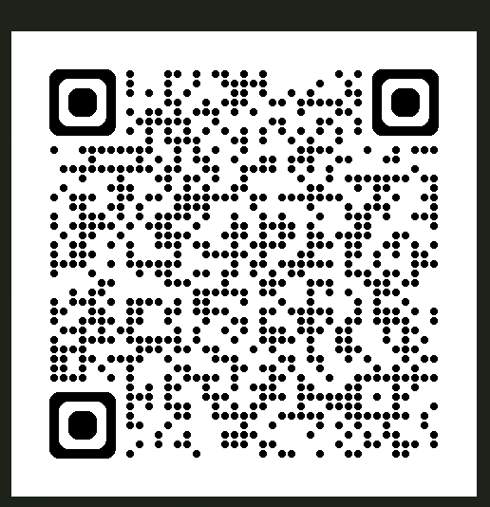
There is:
a QR for individuals responding (parents, carers, professionals),
or if anyone is happy to facilitate a small teams group / in person group, people are able
to send word documents with themes / key points from discussions to Let's Talk County
Durham email address instead LetsTalkCountyDurham@durham.gov.uk clearly marking it
as send local area plan co-production.
The Government is changing how SEND support works across England. These national
reforms focus on supporting children and young people earlier, improving inclusion in mainstream settings, and making sure education, health and care services work better together. To plan for these changes, Durham County Council must produce a Local SEND Reform Plan.
We must work quickly to write a draft plan, and we urgently need to hear from parents and carers of children with SEND, children and young people with SEND as well as schools and settings, and those who support children and families with SEND such as health, care and voluntary and community organisations. Our staff will be reaching out to have conversations over the next two weeks, and we understand that we can’t talk to everybody.
To help us write the plan, please complete our online survey by using the QR code or by this link Help us shape our Special Educational Needs and... | Durham County Council by 8 May 2026 at the latest but the sooner you can do this, the more helpful it will be. There is a survey to hear from children and young people, so please also help your child or children to have their say too.
Thank you for your help and we look forward to preparing a strong plan based on what needs to happen in County Durham to best meet the needs of children and families with SEND.

Slide 5

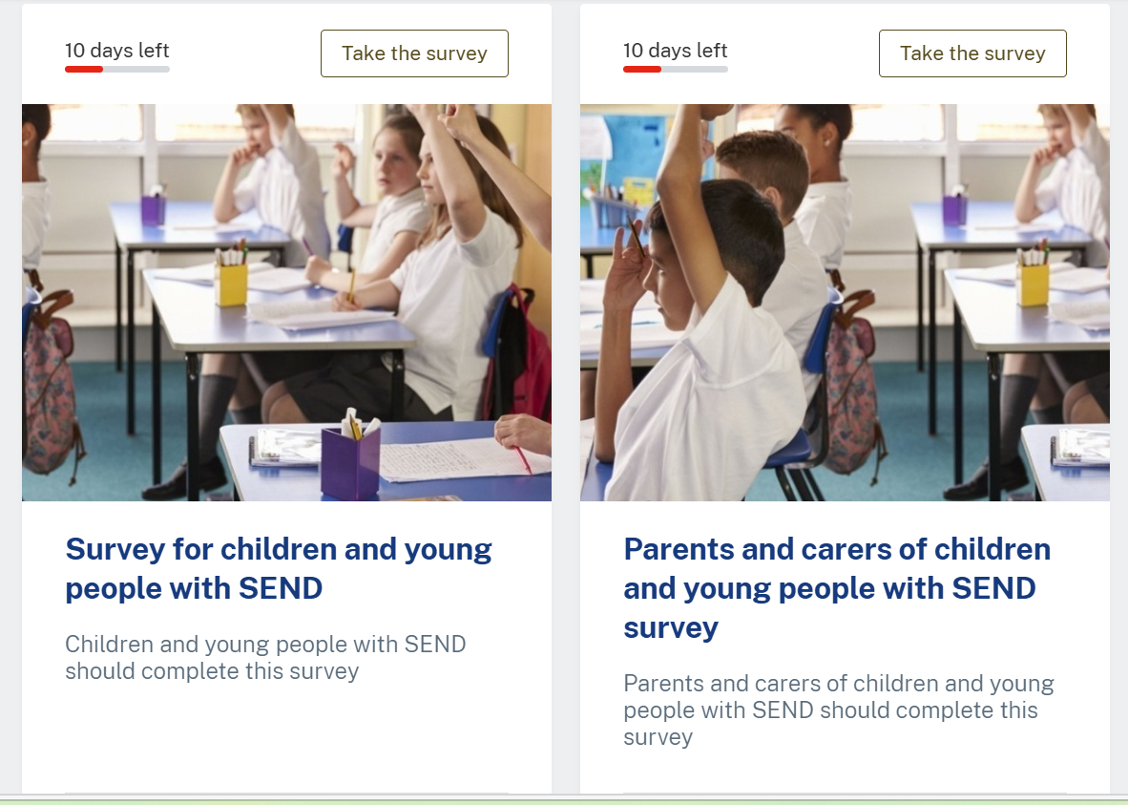

Slide 6
How we support your child, close to home
Support in your local school
We try to meet your child’s needs in their usual nursery or school, as close to home as we can.
Planning with you
You help shape the plan — school staff, the council and families work together.
Inclusion building blocks
Specialist help when needed
If your child needs extra help, specialists can join in early and support your local school.
Your child is welcomed
We build a calm, kind culture so every child feels safe, understood and included.

Slide 7
Support in your local school
Tell me about something your child's school does to help them to succeed?
How welcome and included does your child feel in school? What helps with this?
What does inclusion mean to you?
What other things help them feel included and like they belong?
What are the hardest things for your child day to day?
Identify up to 3 things that you think would help them to have a better experience and achieve more in school?
If just one thing to support you/them better were to be introduced between now and this time next year, what would you like that to be?

Slide 8
Planning with you
Do you know who to contact when you need/ if you needed specialist advice or support for your child?
Did you feel your child was able to access advice or support early enough? Tell me more about that
Has your child been able to access the type of school provision they needed, when they needed it?
What do you want schools and specialist services to understand about the way you have experienced the system?
Identify up to 3 things you would like to see change in relation to access to specialist support, or the development of provision in your child’s school
If just one change were to be introduced between now and this time next year, what would you like that to be?

Slide 9
Specialist help when needed
Do you have an example of when you’ve felt listened to and able to influence decisions about SEND support or services?
Have you seen other clear examples of where parent views influence decisions?
What do you notice about how education, health and care services work together?
When things have been difficult, how did you raise concerns and get them resolved?
How could parent/carer voice best influence system level thinking in your view?
How would you like to be able to influence decisions in relation to the support your own child receives?
If just one thing were to change in the next 12 months to improve the involvement of parents/carers and children in local area planning, what would that be?

Slide 10
Your child is welcomed
How do people who you and your child work with make them feel safe?
Tell me about a really good experience with a professional when they helped build trust?
  What really helped?
  What didn’t help so much?
How are children’s needs understood in Durham?
  What works well?
  What could work better?

