Slide 1

Lisa Kirton
SENDIASS Manager lisa.kirton@durham.gov.uk
Understanding the SEND White Paper 2026 – Every Child Achieving & Thriving
What it means for children, young people and families?

Slide 2

What is a White Paper?
Government policy proposal
Explains planned changes
There is a consultation period
Law does not change immediately
Notes:
A white paper sets out government ideas. It is followed by consultation and potential legislation later. Current SEND law still applies.

Slide 3

Why change the SEND system?
Rising numbers of children with SEND : Around 1.7 million children in England have SEND – which is roughly one in five children in schools across the country.
Nationally there are long waiting times for children to receive support
Difference between areas of England
Ongoing pressure on families, schools and Local Authorities
The Government acknowledges that the current system is not working well
Notes:
Families often experience delays and inconsistency. The government acknowledges the current system is not working well.

Slide 4

Aims of the White Paper
Earlier support
Better inclusion in mainstream schools
Clearer accountability
Less bureaucracy
Notes:
The aim is to fix problems earlier, reduce conflict with families and improve inclusion.

Slide 5
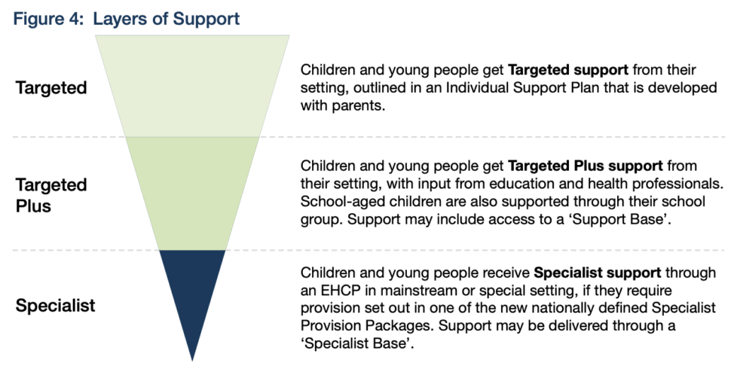
How will children be supported?
Support would be organised in 3 layers
Help and support increases as a child’s needs increase.
Notes:
Support is organised into layers so help increases as needs increase.

Slide 6
Targeted Support
Early help and support, written in an ‘Individual Support Plan’ written with parents
It may include structured support such as speech and language support in small groups or help with sensory needs
high quality teaching
inclusive classrooms
reasonable adjustments

Slide 7
Targeted Plus
Support from the setting plus, more specialist support from education and health professionals, including Speech and Language Therapists and Educational Psychologists who would be called ‘Experts at Hand’
This support would also be recorded through an Individual Support Plan.

Slide 8
Specialist
Children with complex needs will get specialist support through a Specialist Provision Package (SPP)
These children would have an EHCP.
This could be in a mainstream or specialist setting.
The Specialist Provision Packages which would be standardised nationally.
The detail day to day support they will receive will be recorded in their Individual Support Plan.

Slide 9

Individual Support Plans (ISP)
For every child with additional needs including children with an EHCP
Digital record (not just on paper) for parents and teachers
Every nursery, school and college will have a legal duty to create an ISP for every child with SEND
Reviewed regularly with parents to make sure it is suitable for your child
Notes:
The ISP records day-to-day support and should be written with parents.

Slide 10
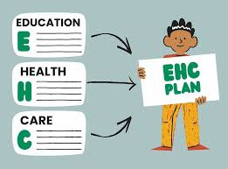
What about EHCPs?
EHCPs remain but they would be digital
For children with the most complex needs
The provision will be linked to a Specialist Provision Package
No child would ‘loose’ their existing EHCP or be asked to leave a special school. May be a re-assessment for younger children in mainstream schools.
Notes:
EHCPs are not being removed and continue to protect children with complex needs.

Slide 11

Will teachers be trained to help support children?
Yes. Every school, college and nursery will be expected to train their staff to adapt their teaching for children with special educational needs.
£200 million of funding in a new training programme, to make sure that every teacher knows how to support every child in their classroom and give them the help they need.

Slide 12
What are Experts at Hand?
Children in mainstream settings who need support from specialists will be supported through a new programme called Experts at Hand.
The new Experts at Hand service will increase the support available in mainstream schools, colleges and nurseries by offering access to specialist expertise. This includes occupational therapy, educational psychology, and speech and language therapy support.
Around £1.8 billion over the next three years for local areas to design and implement the new Experts at Hand offer and develop this new service.
The aim is with better access to specialist support; many children may no longer need an EHCP to access the support they need because it will be readily available to them.

Slide 13
Inclusion Bases
A dedicated space in a mainstream school that can offer specialist teaching or targeted support for children and young people with additional needs.
The government has set an expectation that in time, every secondary school will have an inclusion base
The bases could be used for small group work such as reading and writing, or for children struggling with a busy school environment, a space to teach an adapted curriculum or for 1-2-1 personal care.
Over £3.7 billion of funding will create the Inclusion Bases as well as 60,000 specialist places in nurseries, schools and colleges. (Nationally)

Slide 14
What stays the same?
Current SEND law still applies
Support should not be reduced
Rights remain protected
Notes:
No setting should reduce support because of the White Paper.

Slide 15

What happens next?
After a white paper is published, it undergoes a period of public consultation where the government gathers feedback from interested groups and the public before deciding whether to move forward with a formal Bill to change the law.
SEND consultation is open now

Slide 16

What happens after the Consultation
Decision Making: Officials review the feedback to determine if adjustments are needed.
If the government decides to proceed, they draft a Bill—a formal document that serves as a proposal for a new law.
The Bill must then go through various stages in Parliament in both the House of Commons and the House of Lords.
Royal Assent: Once both houses agree on the final text, it receives Royal Assent to become an Act of Parliament (law)
Notes:
Parents and carers are encouraged to share their experiences.

Slide 17
Key messages
Proposals not law yet
EHCPs are staying
Change will be gradual
Notes:
The key message is reassurance and gradual change.

